Slide 1
Collective Magnetism in Long-Range
Ordered Structures of Magnetic Nanoparticles
PhD Defense | Disch Group | Department of Chemistry | Dominique Dresen | 25.03.2019

Slide 2
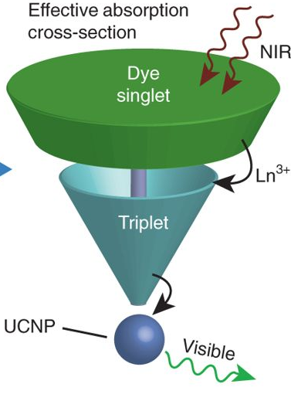
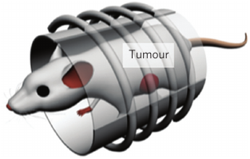
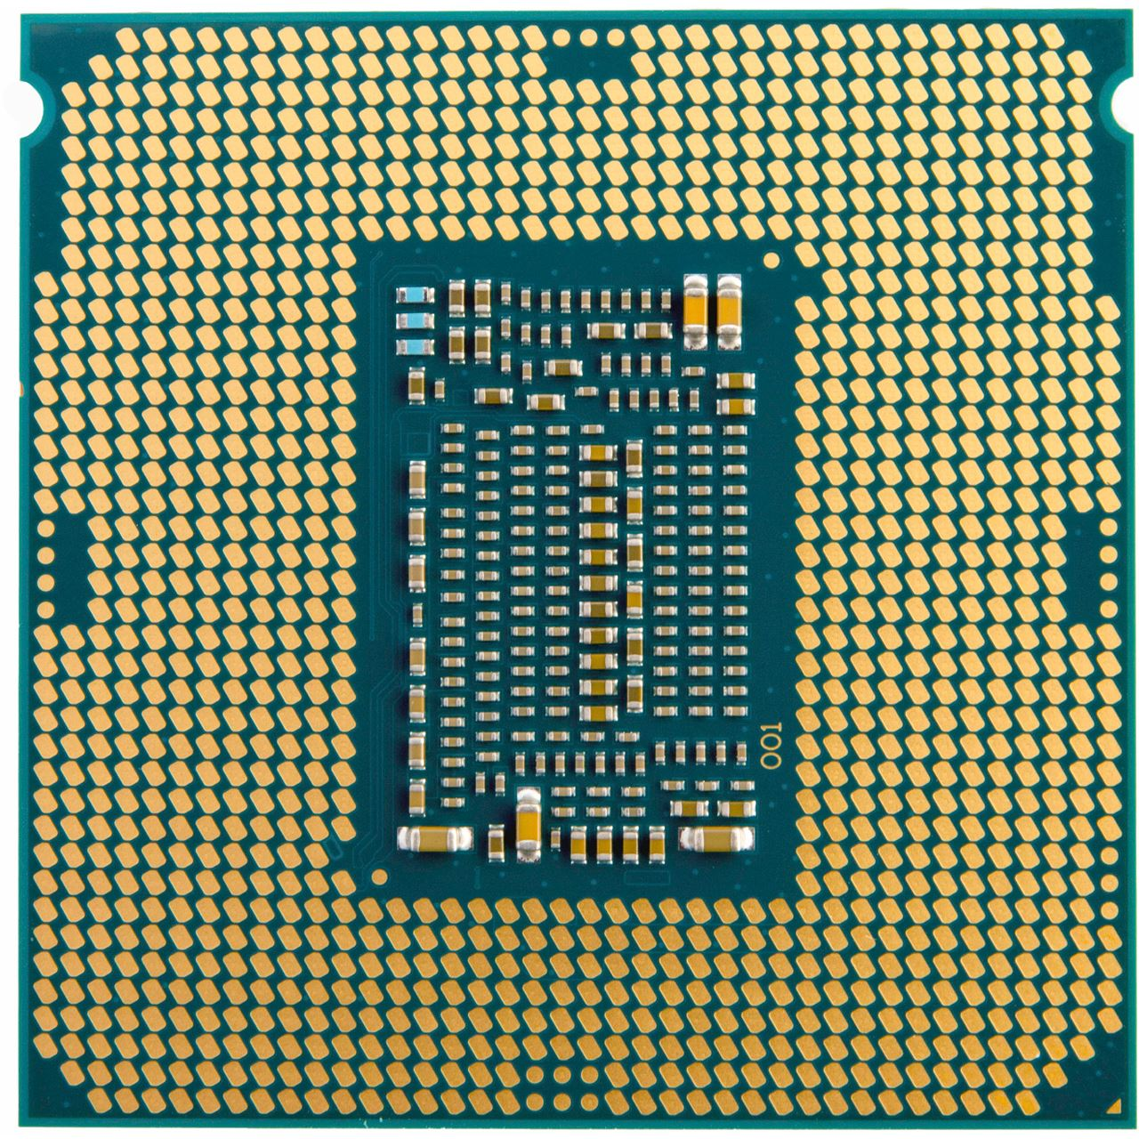
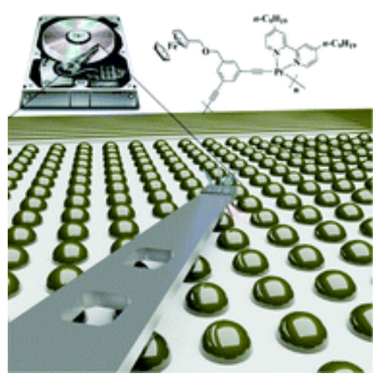
Introduction
Nanotechnology presents great potential for breakthroughs in
medicine^{[1]}
energy production/storage^{[2]}
electronics & information technology
Self-assembly
fabricate nanostructured devices
being precise, flexible in material choice & having a low production cost
Magnetic Nanoparticles
e.g. for bit-patterned high-density magnetic recording media^{[3]}
→ requires understanding of interparticle interaction
[1] J.-H. Lee et al., Nature Nanotechnology, 2003, 6, 418-422.
[2] D. J. Garfield et al., Nature Photonics, 2018, 12, 402-407.
[3] Z. Meng et al., Nanoscale, 2017, 9, 731-738.
1

Slide 3
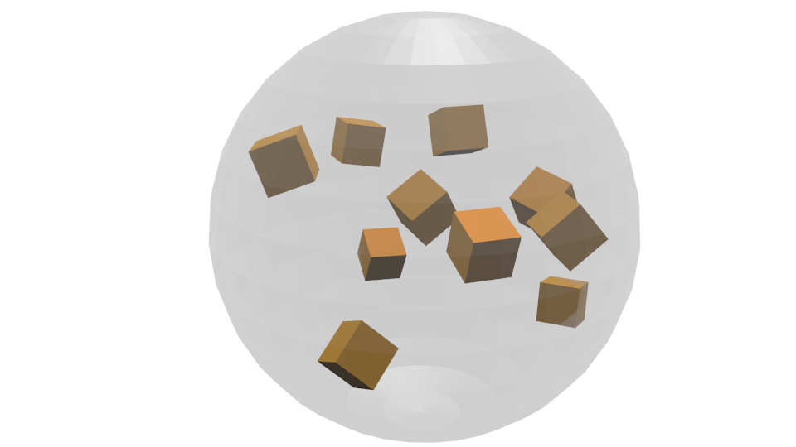
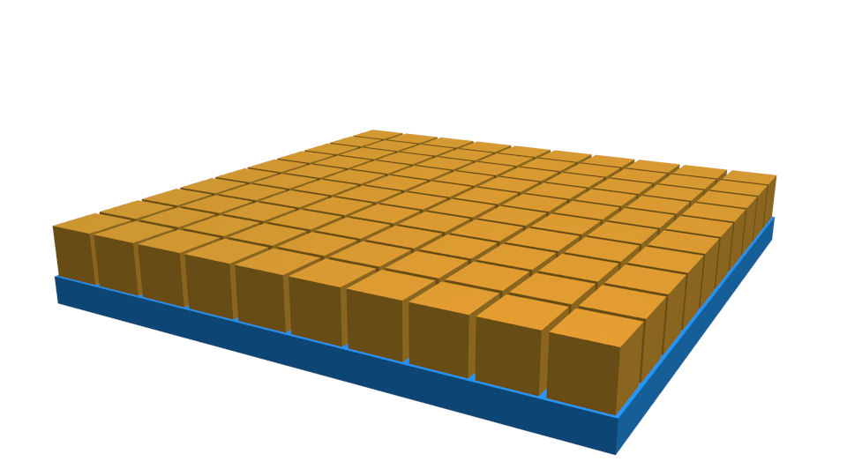
Concept & Exp. Methods
Individual NP Properties
Collective Properties
Nanoparticle Morphology
Crystal Structure
Elemental Composition
Size & Size Distribution
Non-interacting magnetic properties
Lateral order
Vertical structure
Dipolar Interaction effects
Electron Microscopy (TEM / EDX)
X-Ray Diffraction (XRD)
Vibrating Sample Magnetometry (VSM)
Small Angle X-Ray / Neutron Scattering (SAXS / SANS)
Scanning Electron Microscopy (SEM)
X-Ray Reflectometry (XRR)
(Polarized) Neutron Reflectometry (PNR)
Grazing-Incidence Small-Angle X-Ray / Neutron Scattering (GISAXS / GISANS)
1

Slide 4
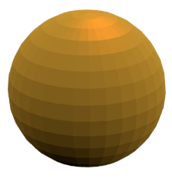
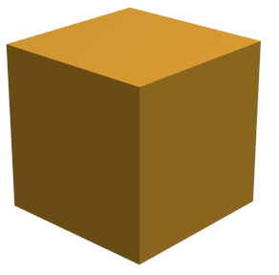
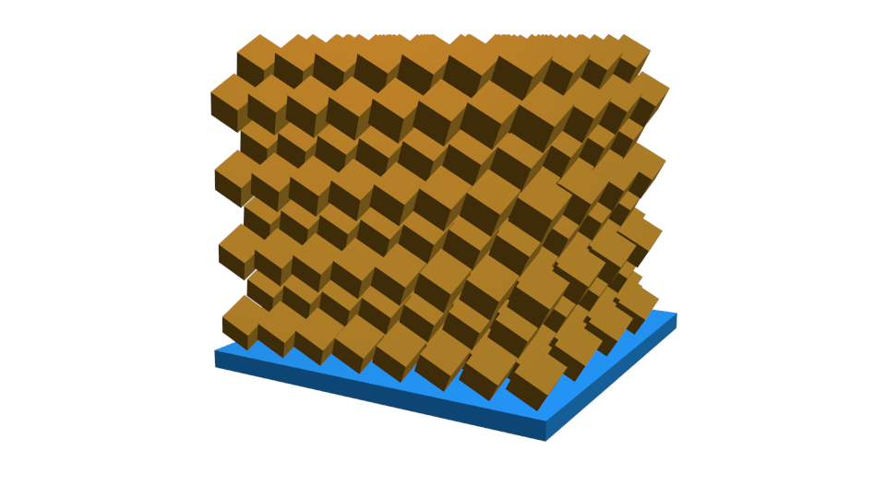
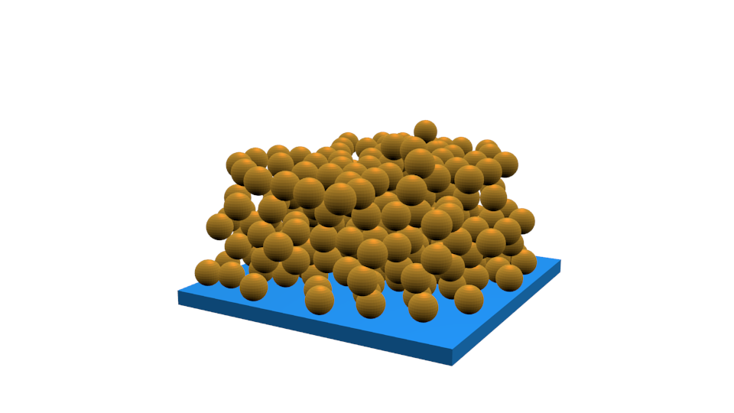
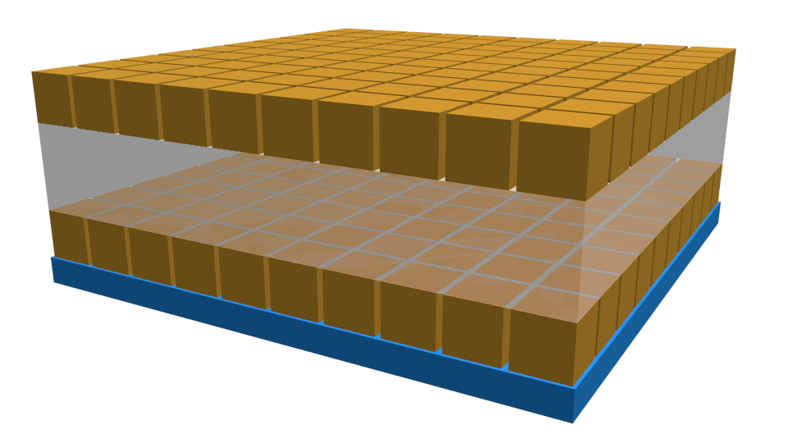
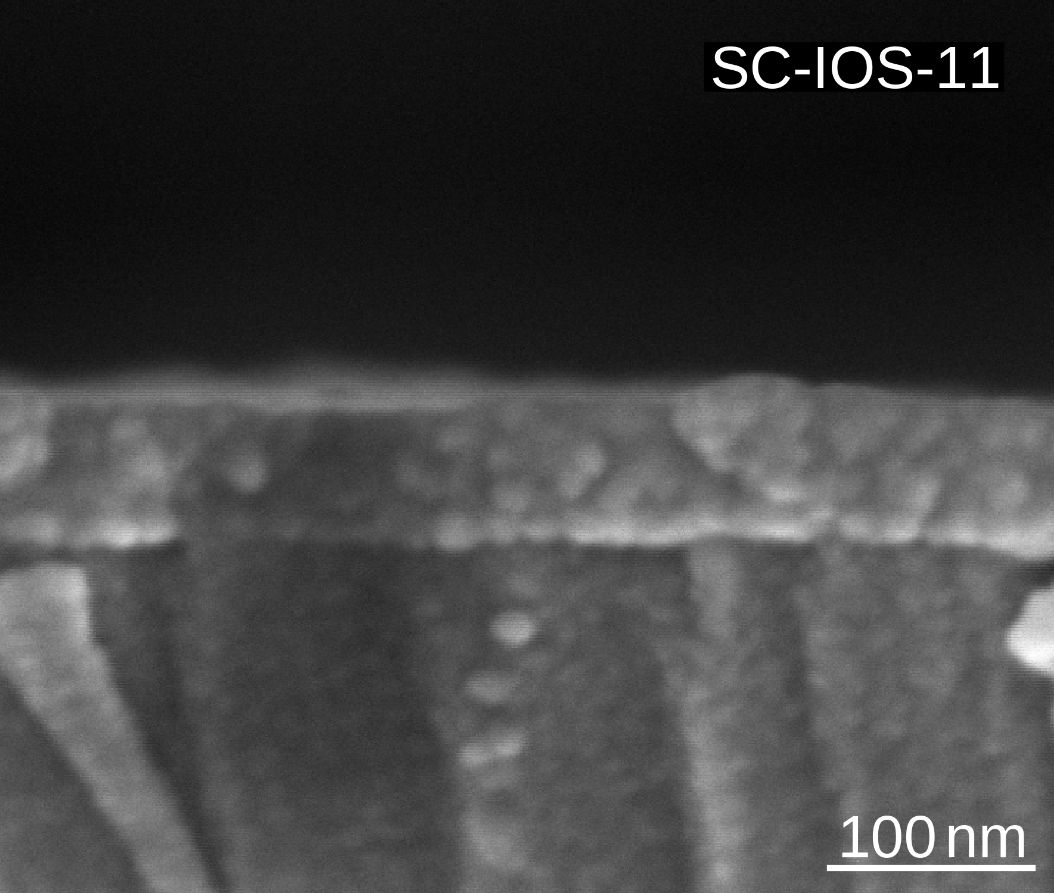
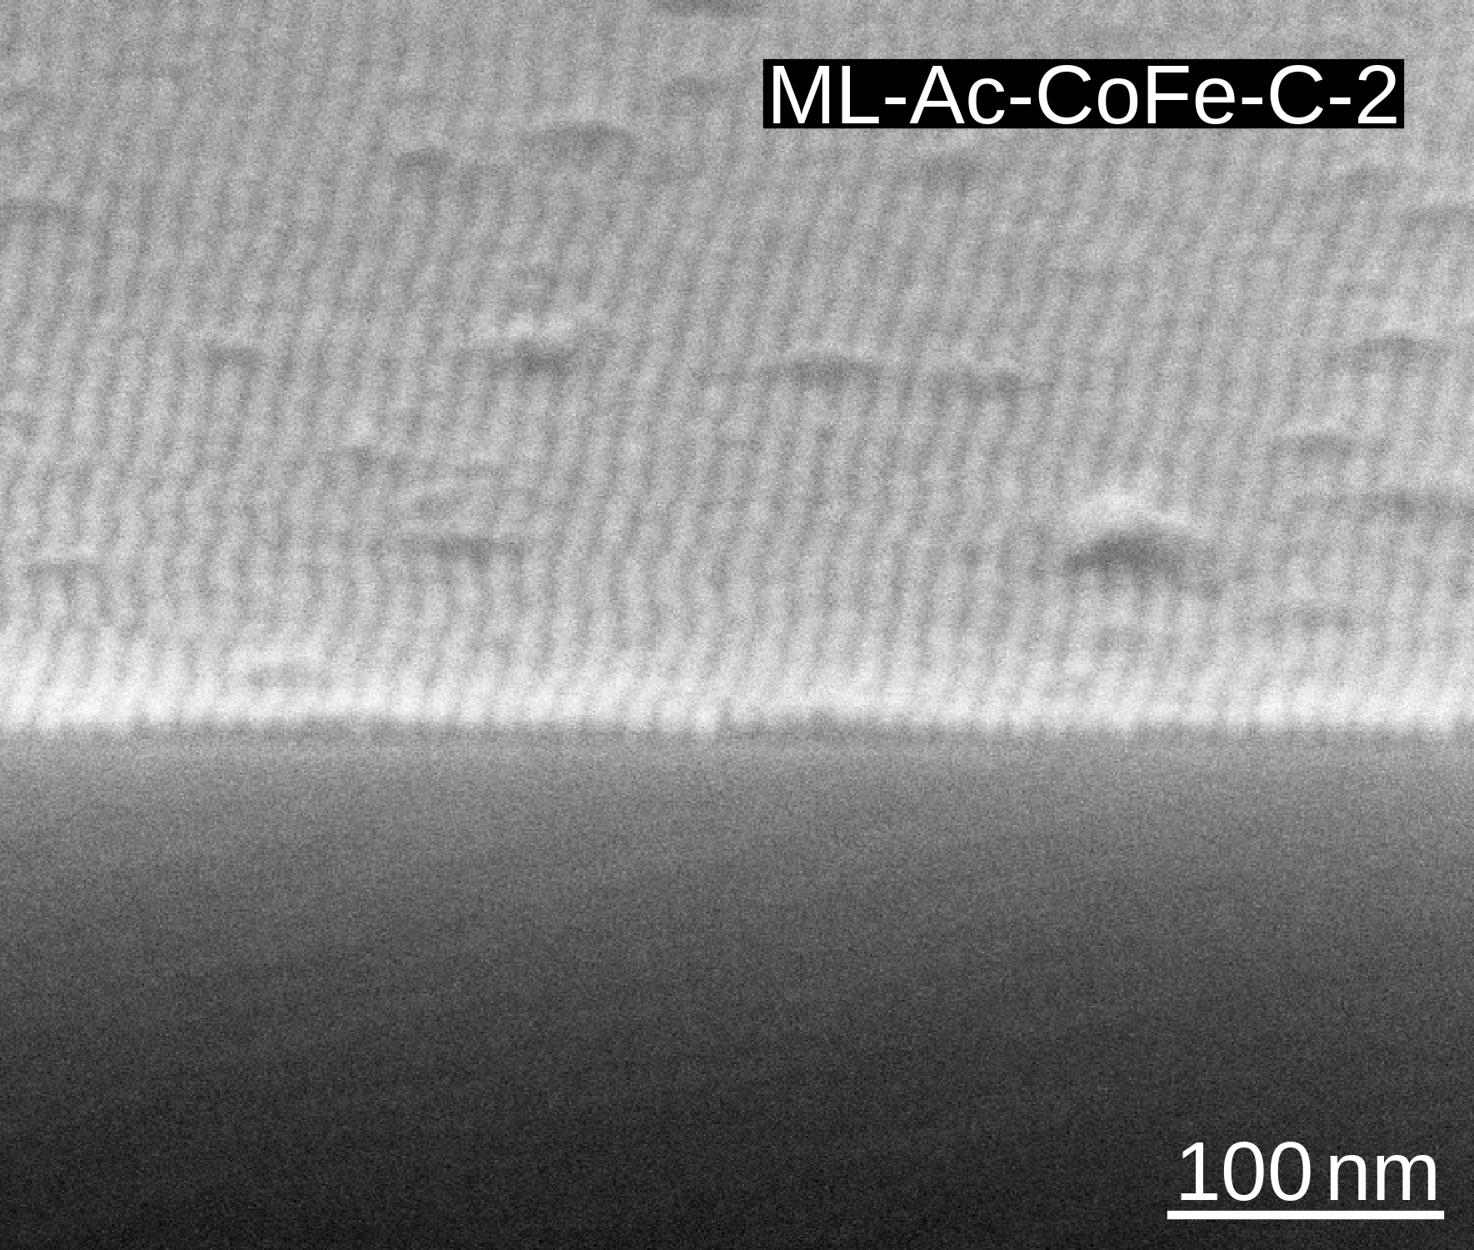
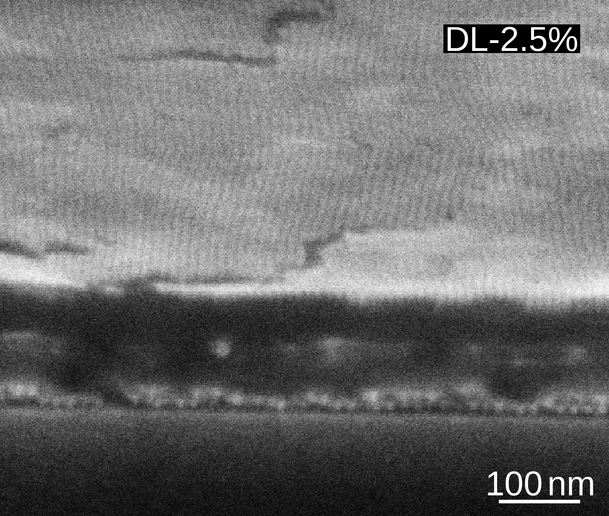
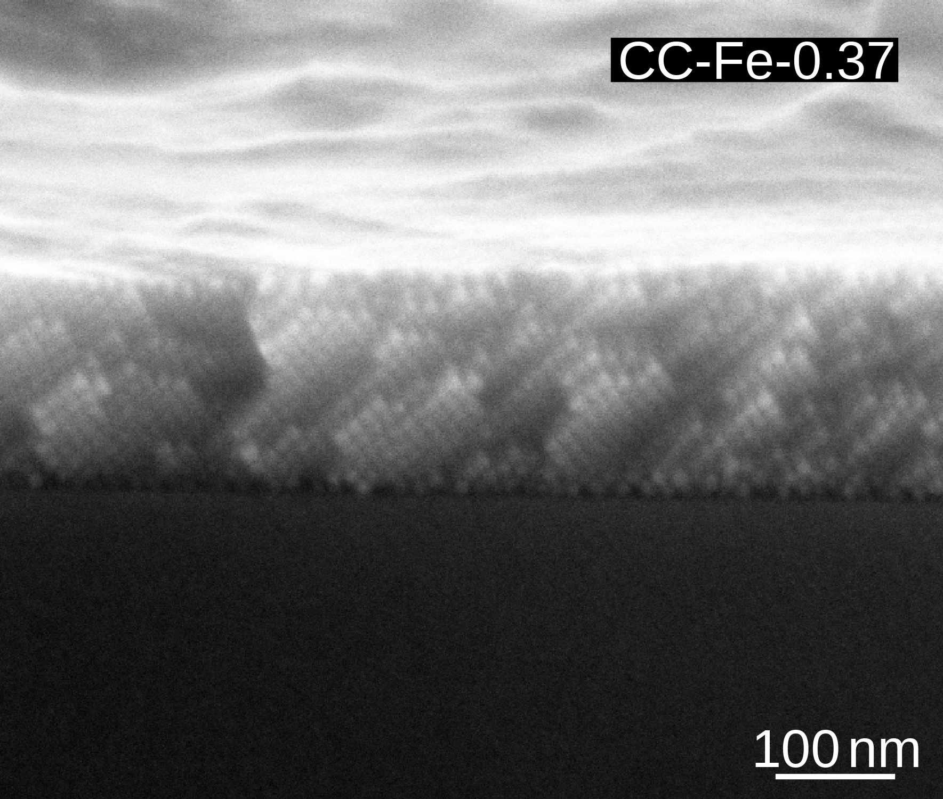
Self-Assembled Nanostructures
Nanoparticles
spherically & cubically shaped
Fe_{3-δ}O₄ & CoFe₂O₄
Loosely-Packed Nanospheres
Monolayers
Double Layers
Colloidal Crystals
1

Slide 5
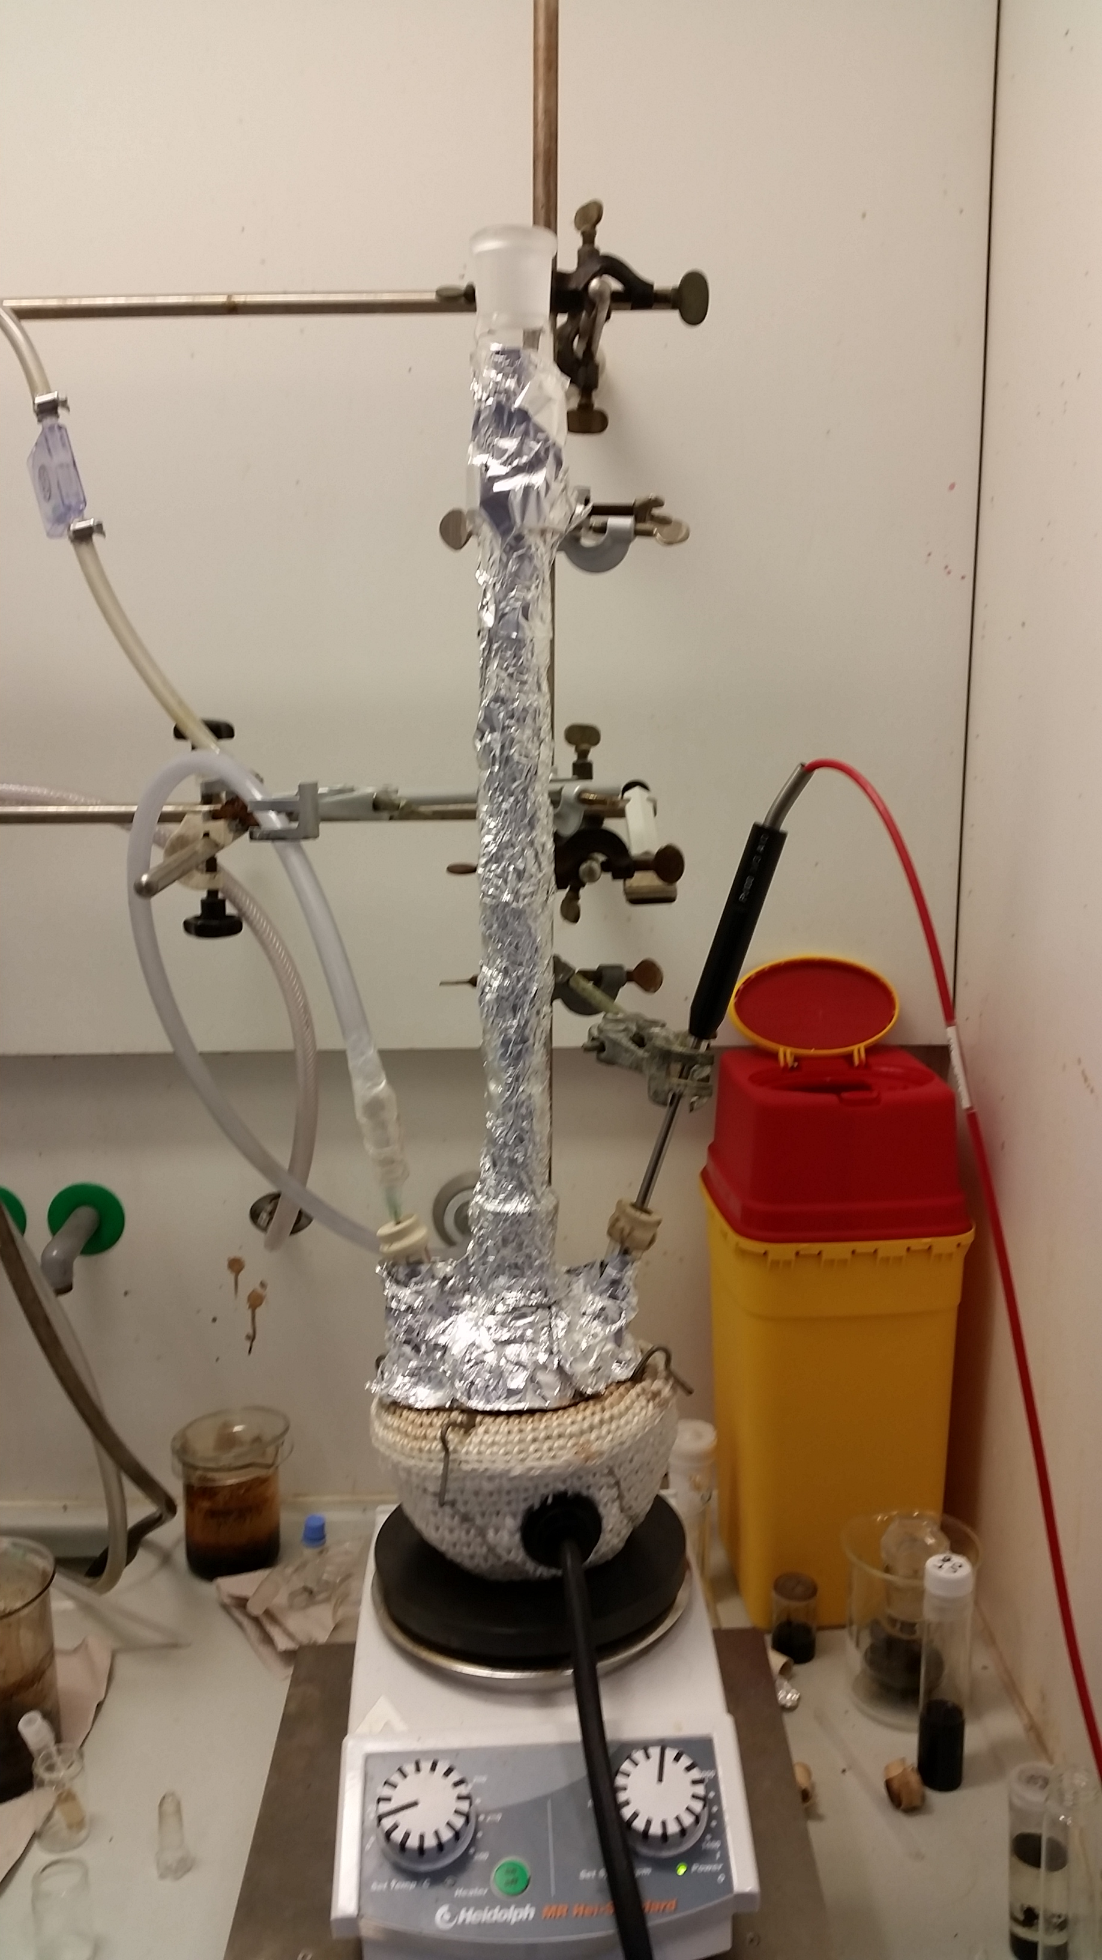
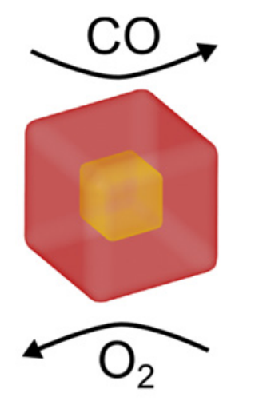
Nanoparticle Synthesis
Thermal decomposition by heating up method iron/cobalt-
Oleates^{[1, 2, 3]}
Acetylacetonates^{[5]}
wüstite phase oxidizing to inverse spinel^{[2,4]}
single inverse spinel phase
- core-shell structure and/or anti-phase boundaries → reduced magnetic moment
+ size distribution < 10%
+ strongly magnetic
- size distribution 10 ~ 15%
[1] T. Hyeon, ChemComm, 2003, 0, 927–934.
[2] E. Wetterskog et al., Sci. Technol. Adv. Matter, 2014, 15, 1–9.
[3] N. Bao et al., Chem. Mater., 2009, 21, 3458–3468.
[4] E. Wetterskog et al., Nanoscale, 2016, 8, 15571.
[5] L. Wu et al., Nano Lett., 2014, 14, 3395-3399.
5
Thermal decomposition following 2 routes
from iron/cobalt oleates in 1-octadecene^{[1, 2, 3]}
core/shell structure:
wüstite phase oxidizes to inverse spinel^{[2,4]}
precise control of size & morphology
size distribution ~5% attainable
reduced magnetization even after full oxidation due to
topotaxial oxidation & formation of anti-phase boundaries^{[4]}
from iron/cobalt acetylacetonates in dibenzyl ether^{[5]}
inverse spinel phase
size distribution typically in order of 10 ~ 15%
strongly magnetic

Slide 6
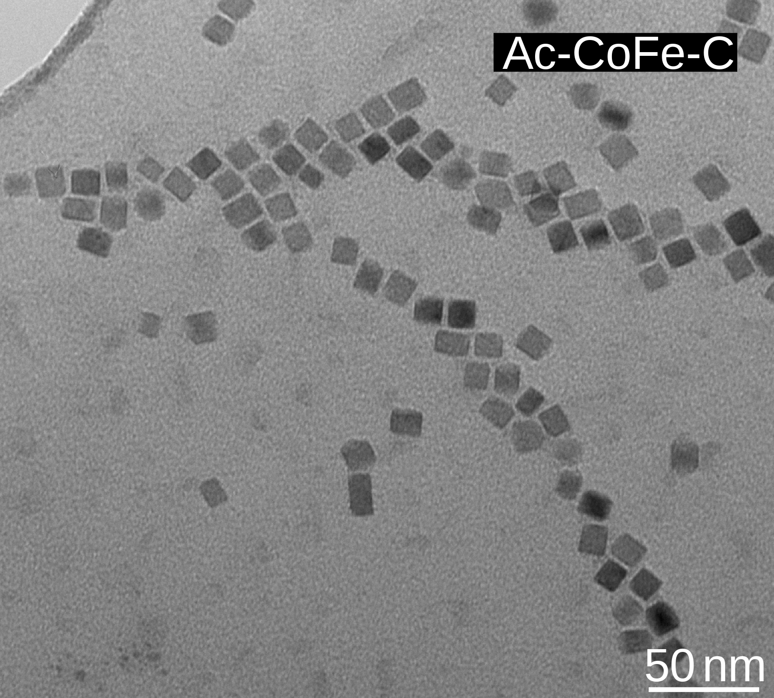
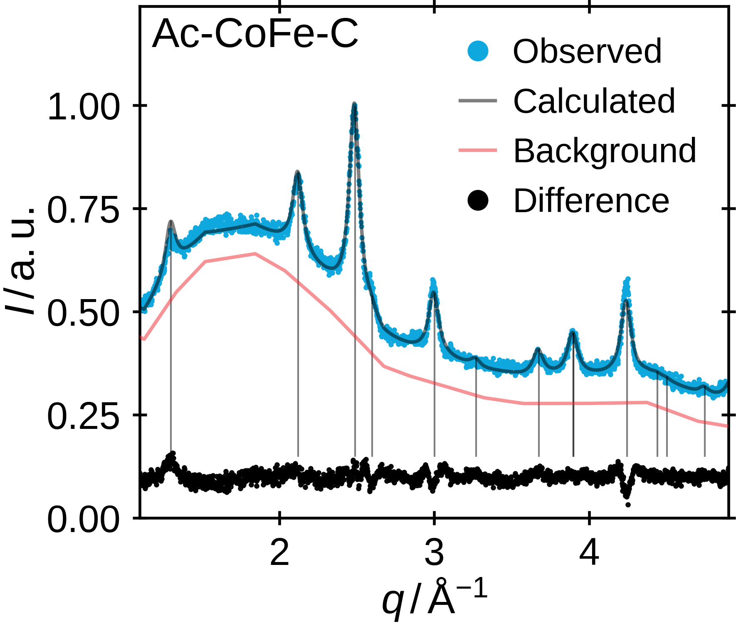
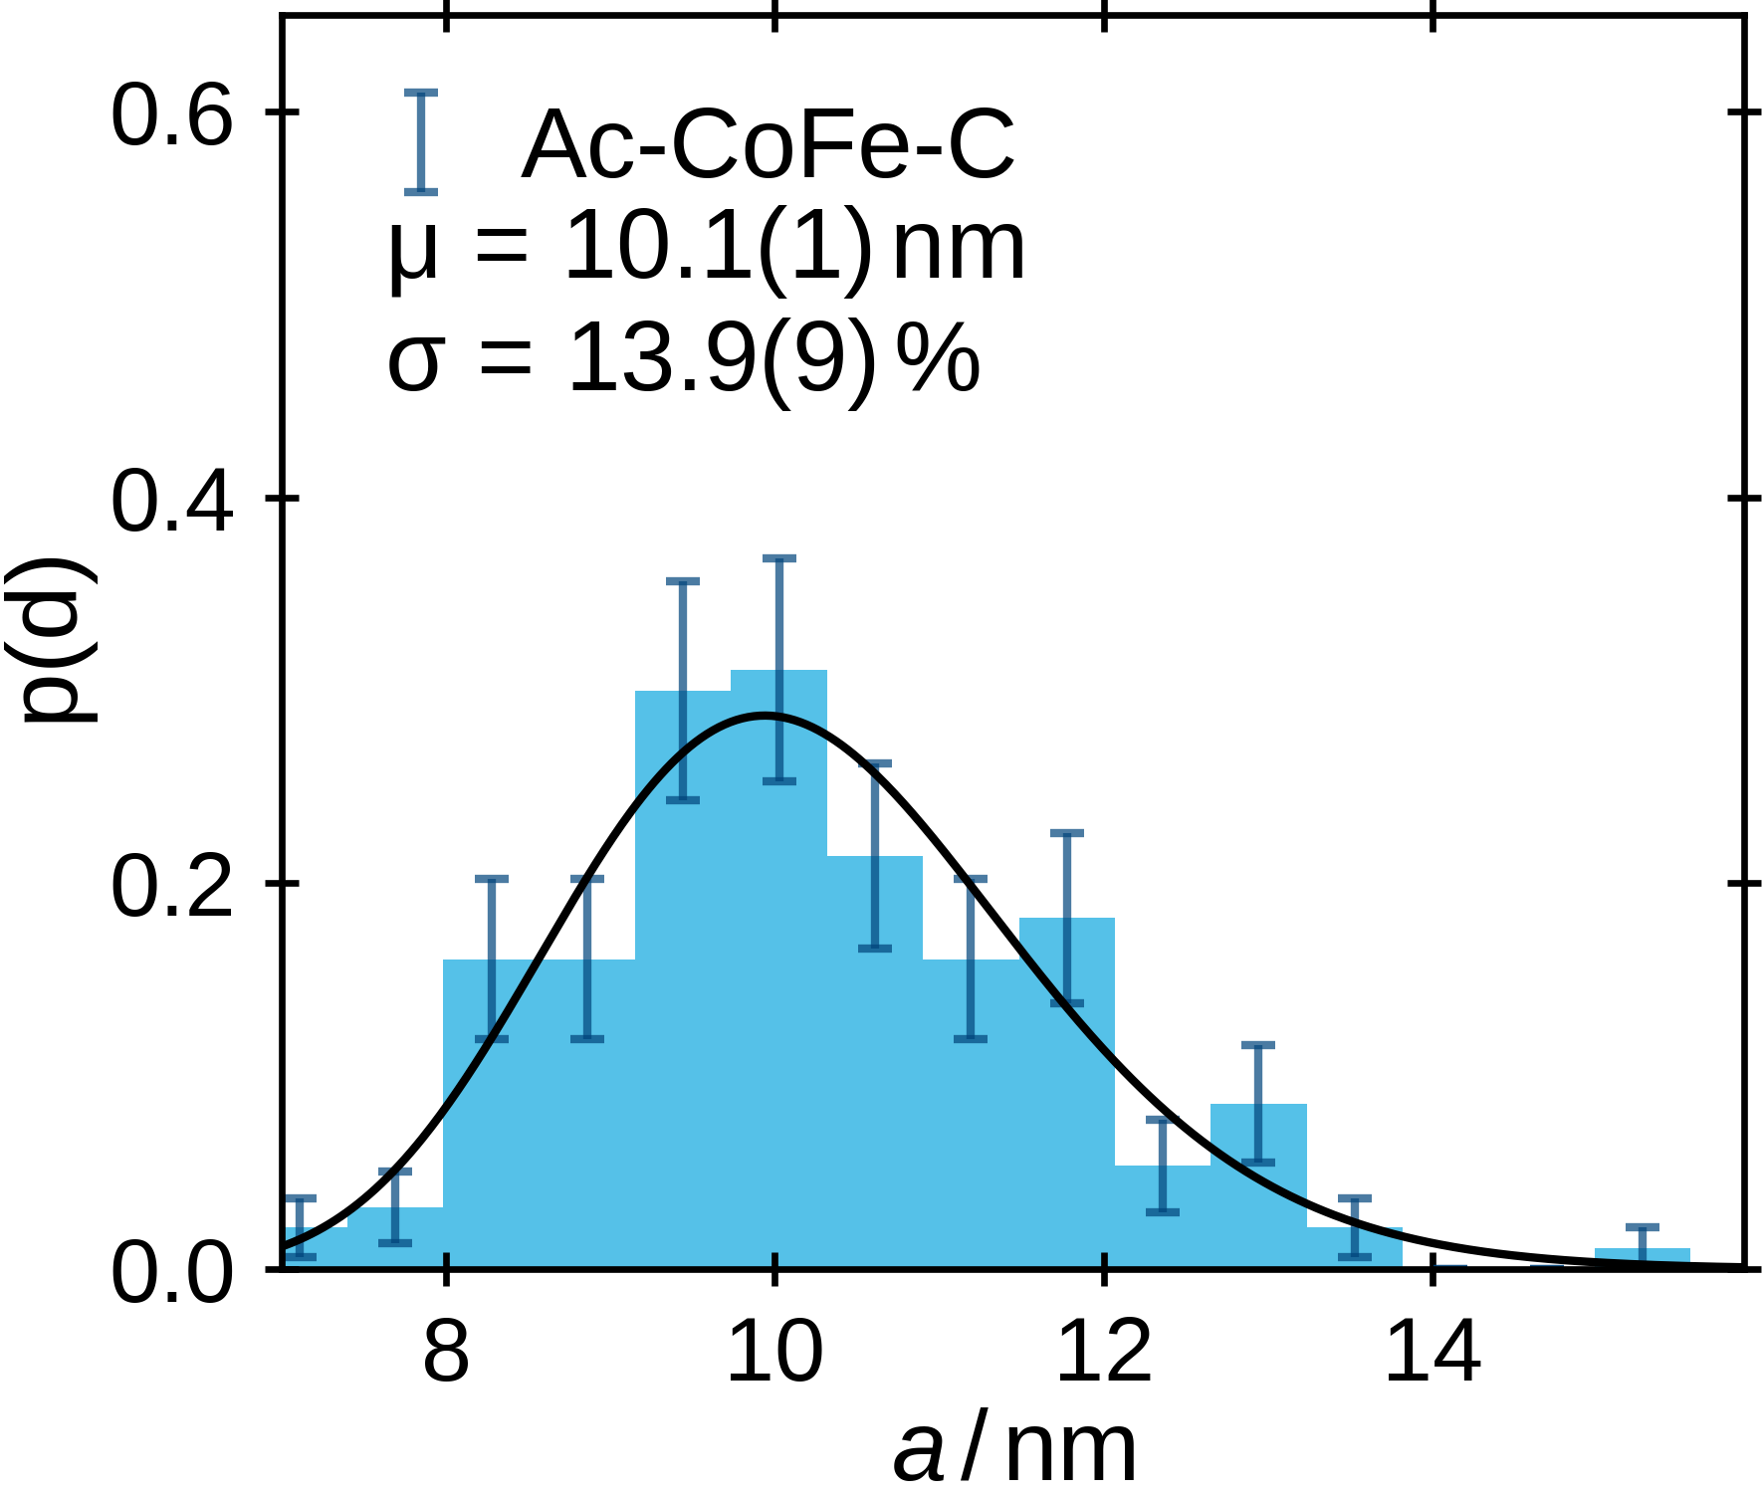
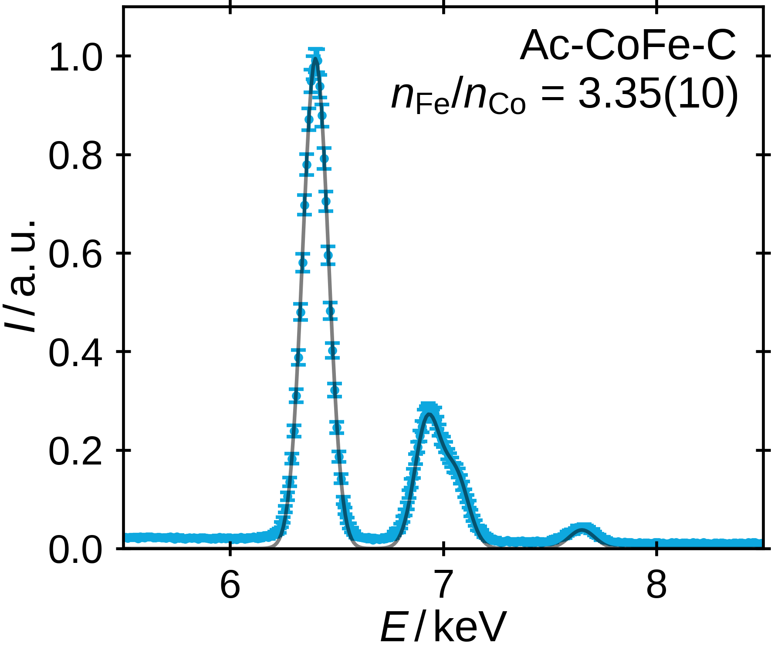
Nanoparticle Structural Characterization
Particle Morphology
Crystal Structure & Size
Cobalt-to-Iron Ratio
6

Slide 7
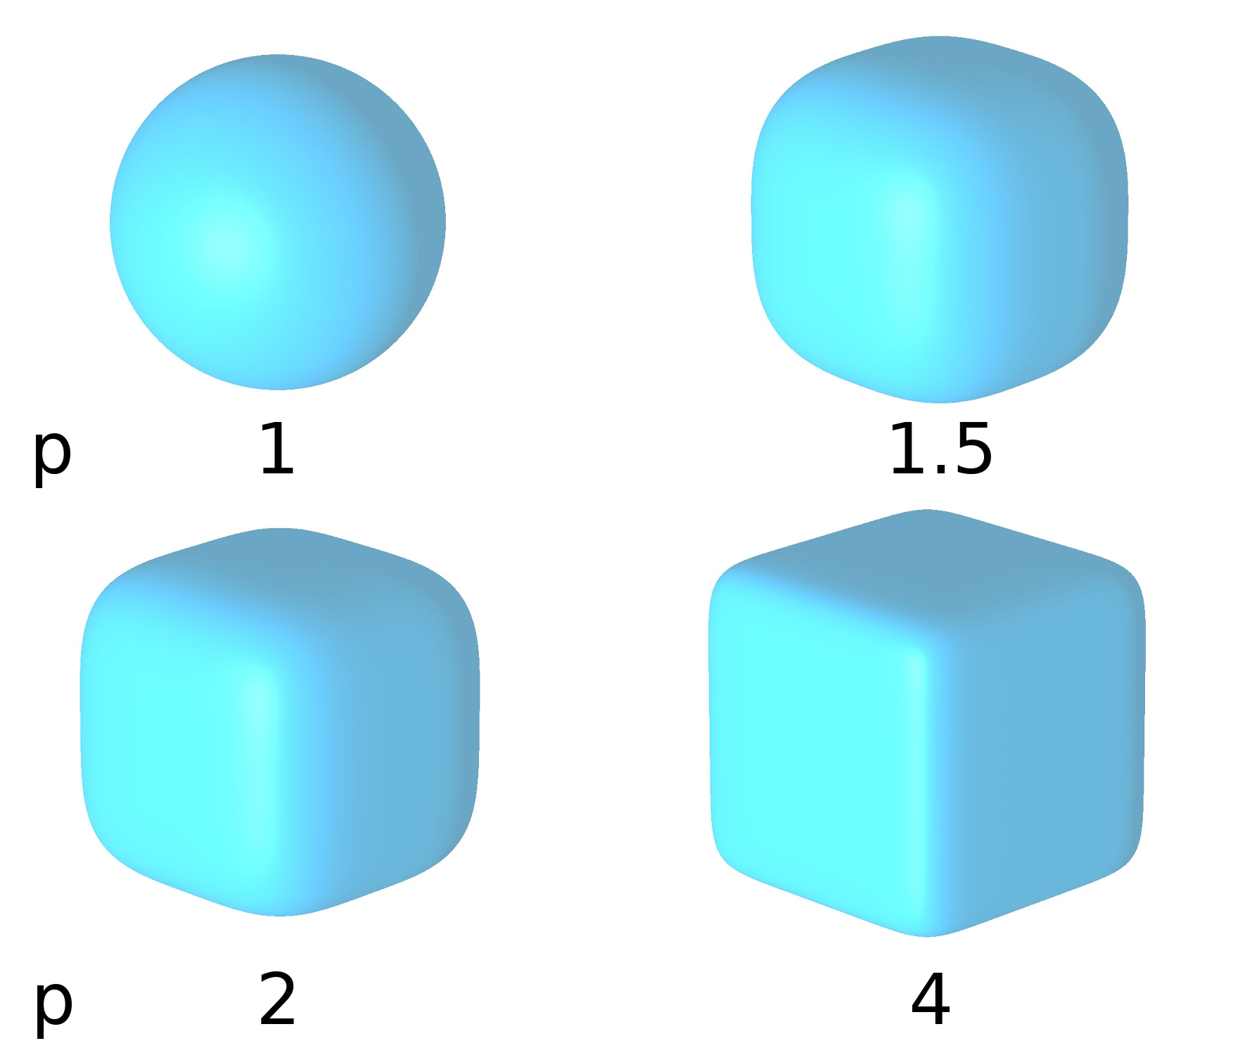
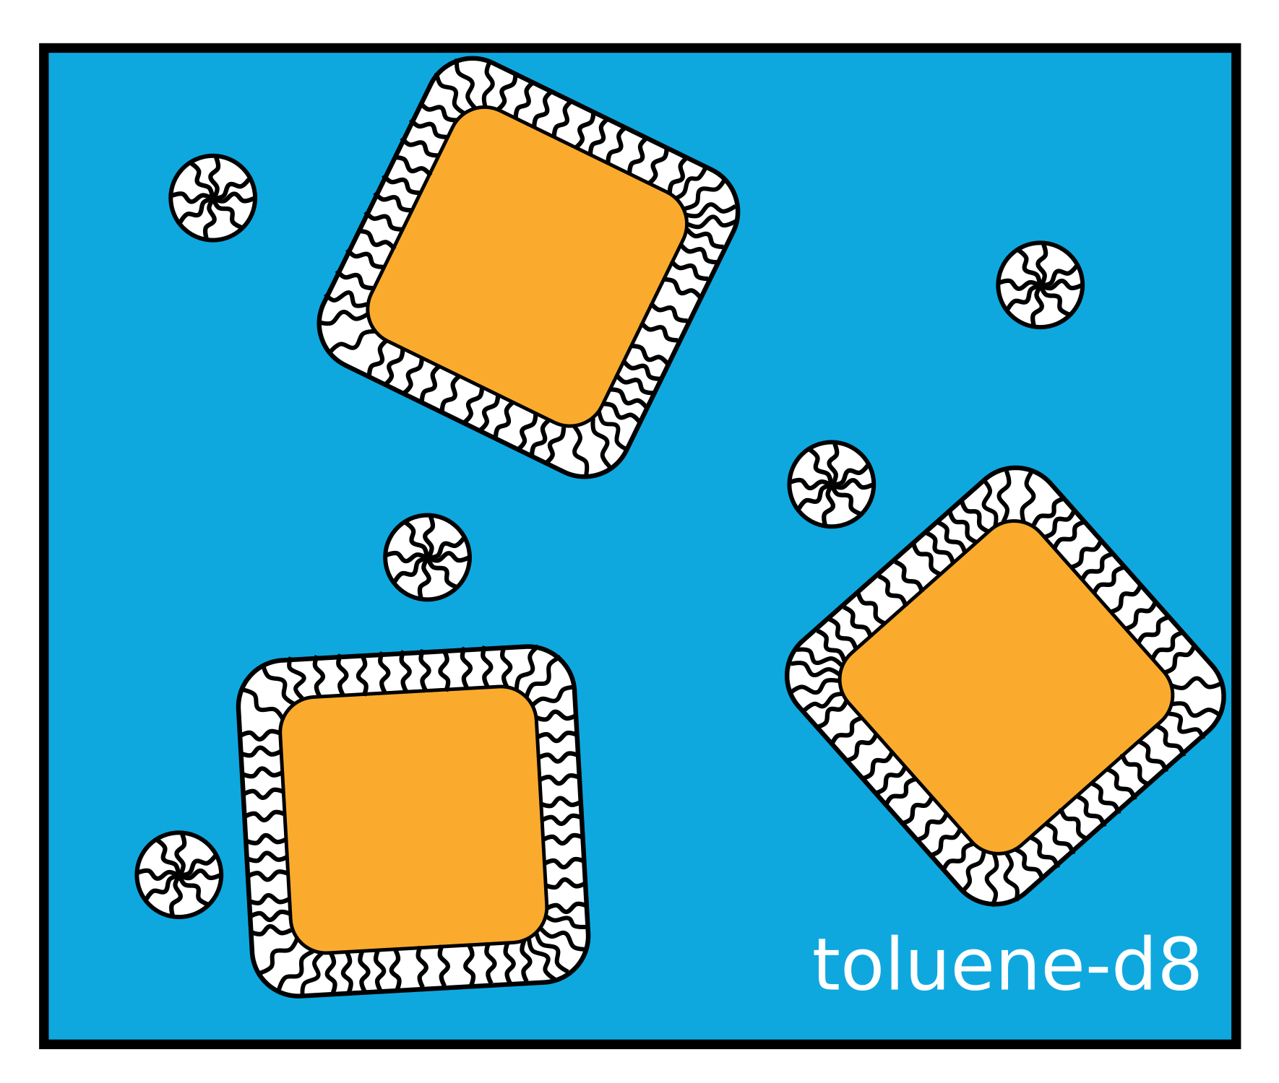
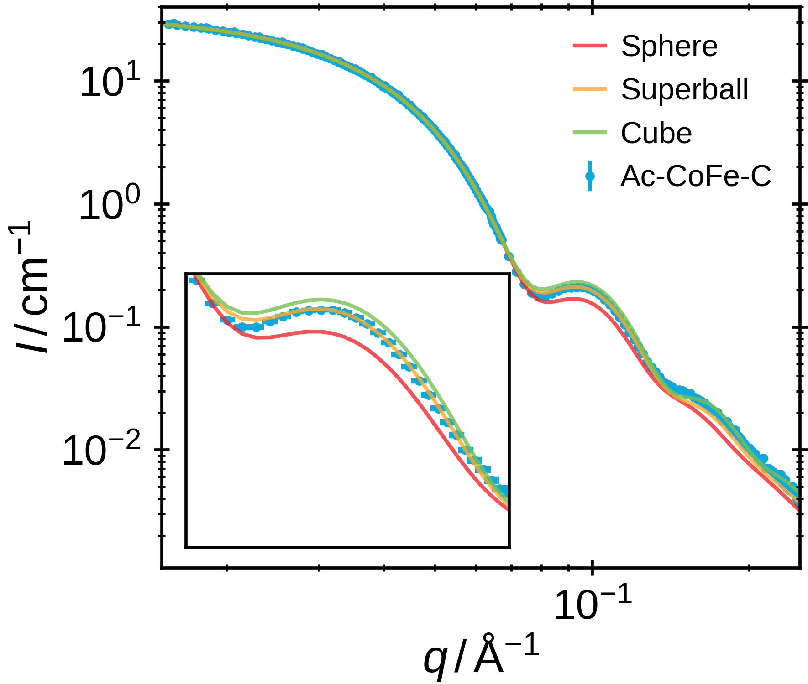
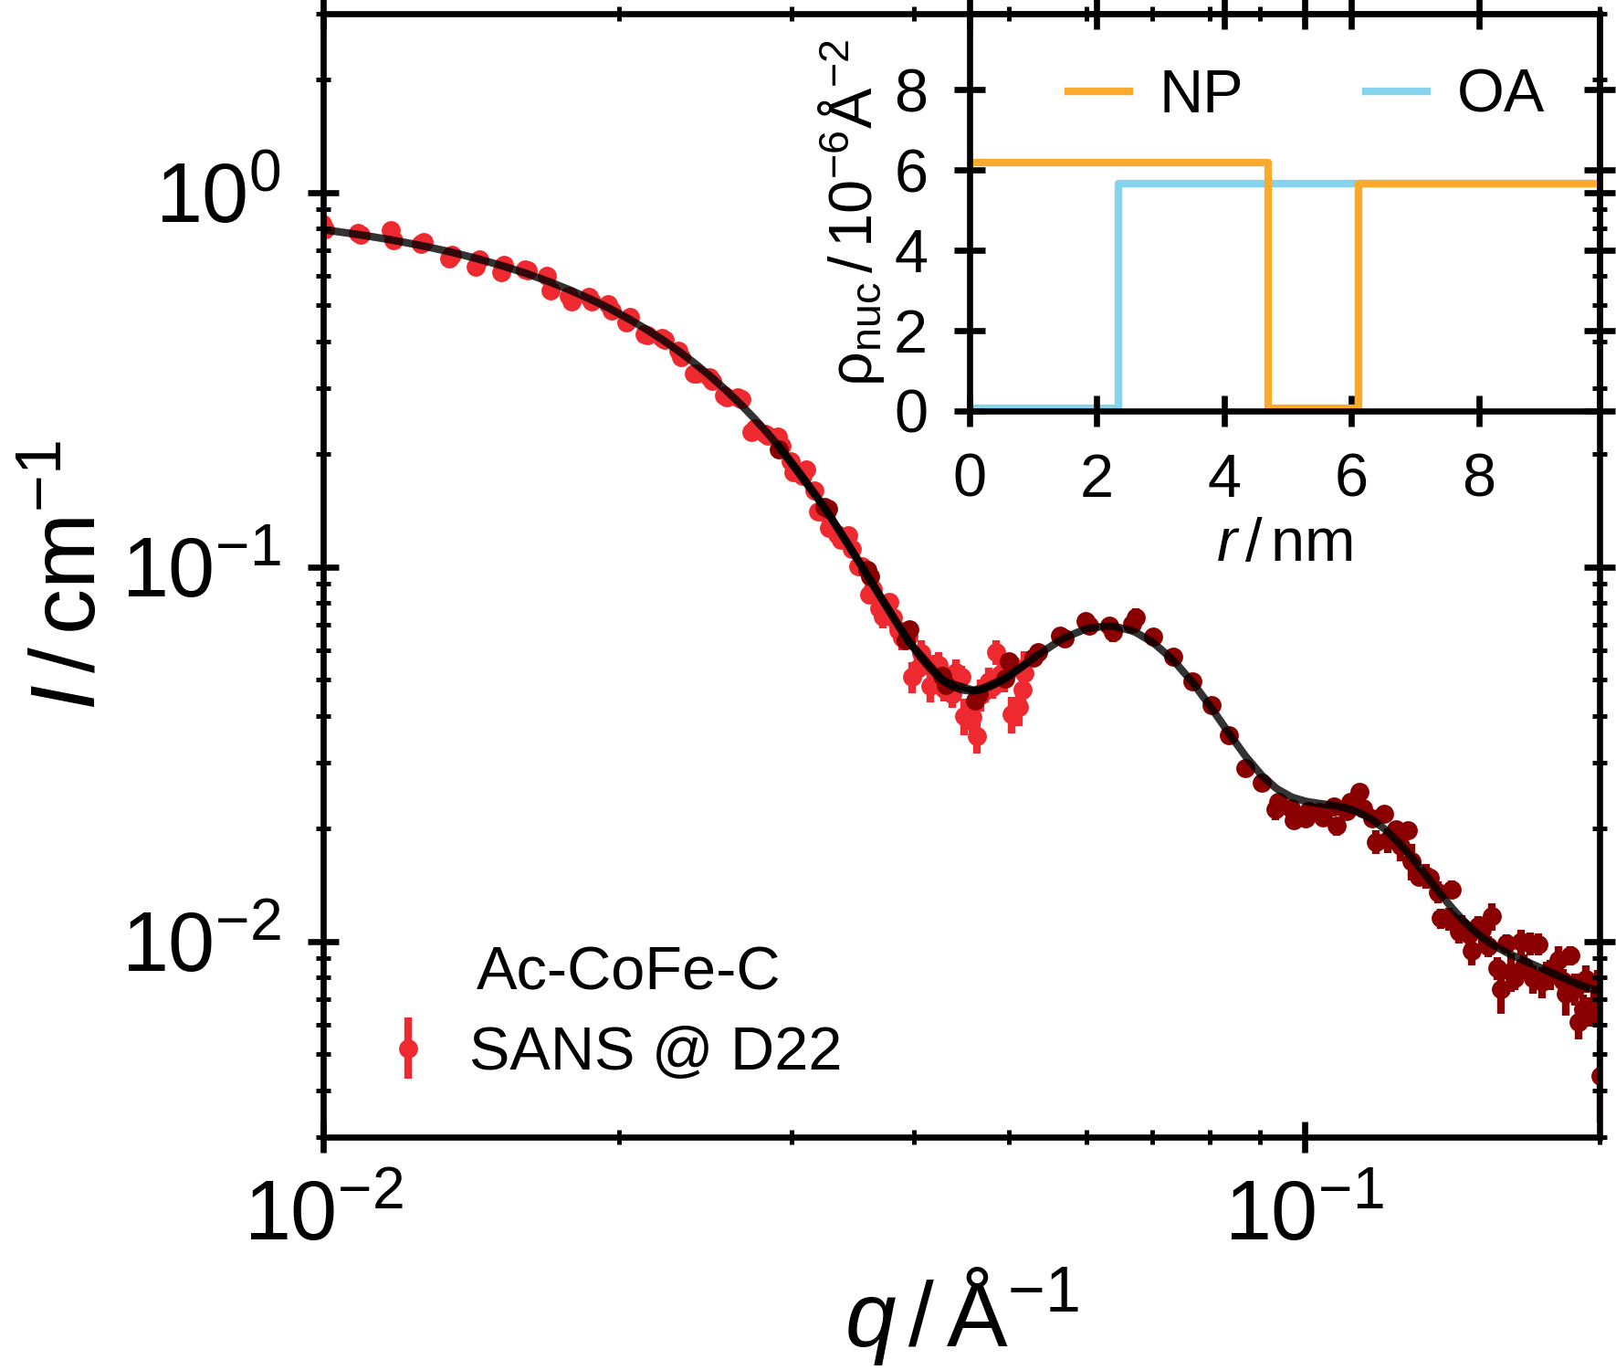
Small-Angle Scattering - Superball Form Factor
Size, Size-Distribution,
Electron / Nuclear Density Profile
Superball: continuously transition sphere → cube
7

Slide 8
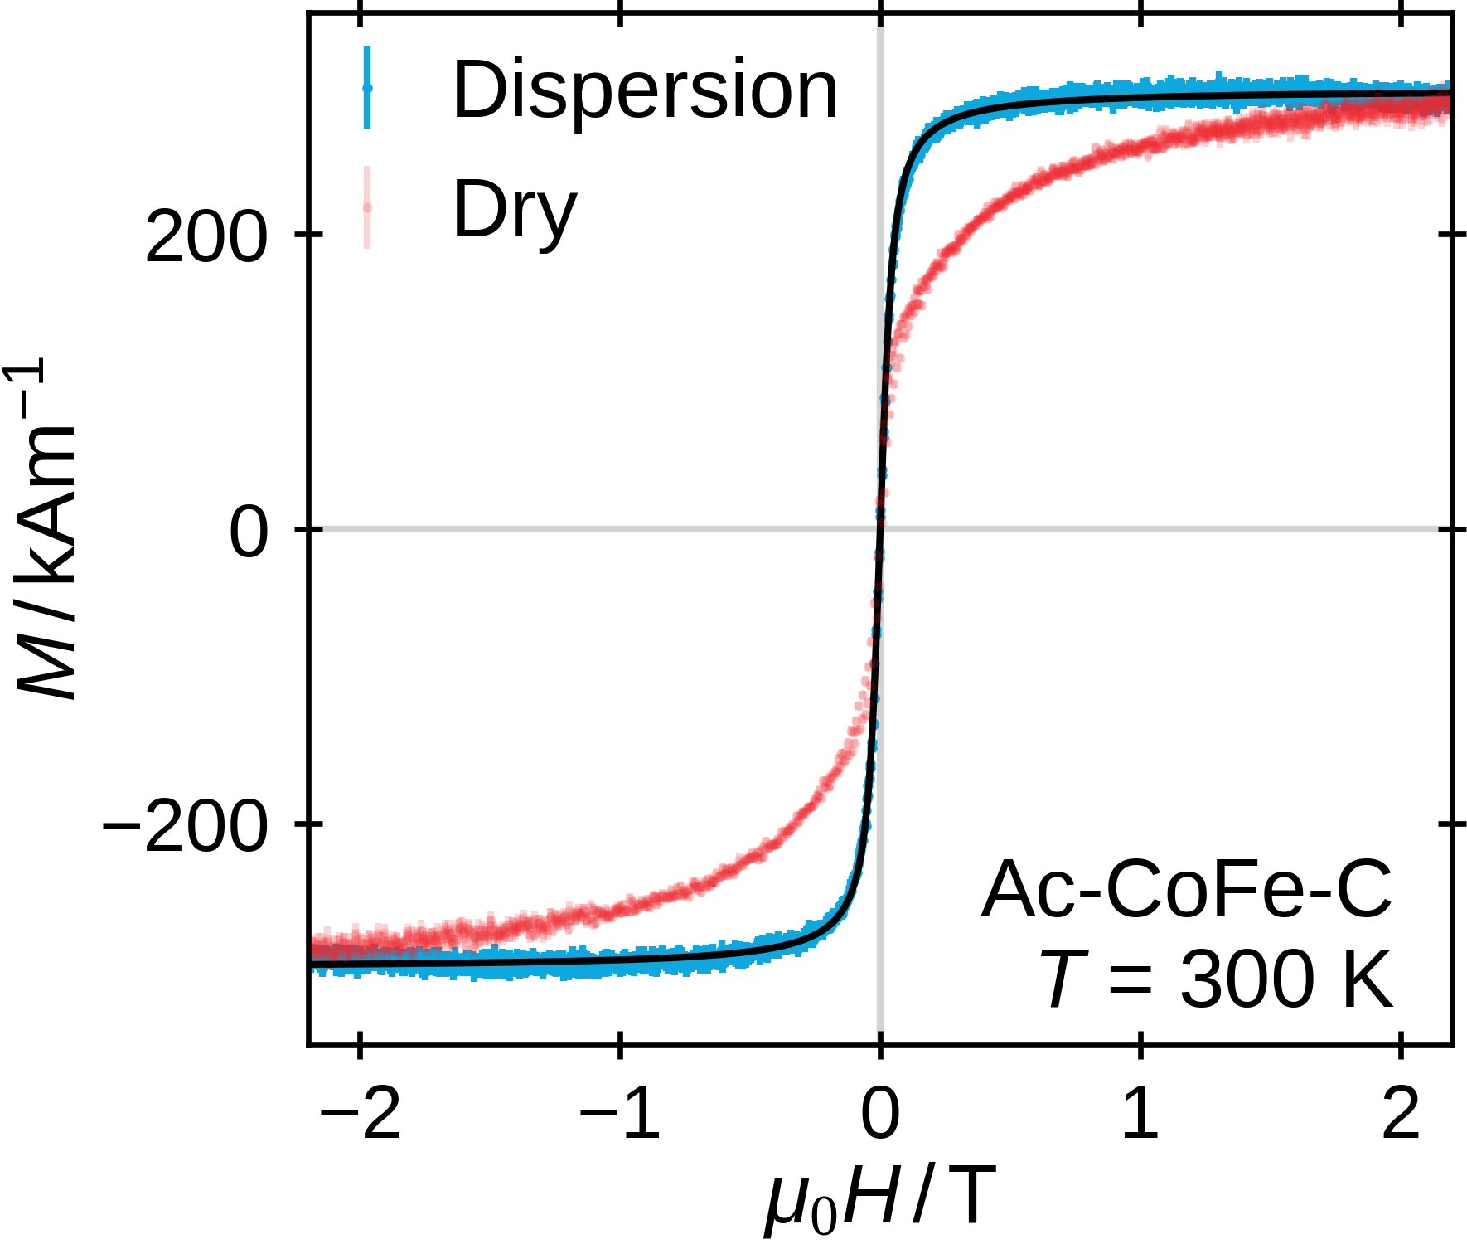
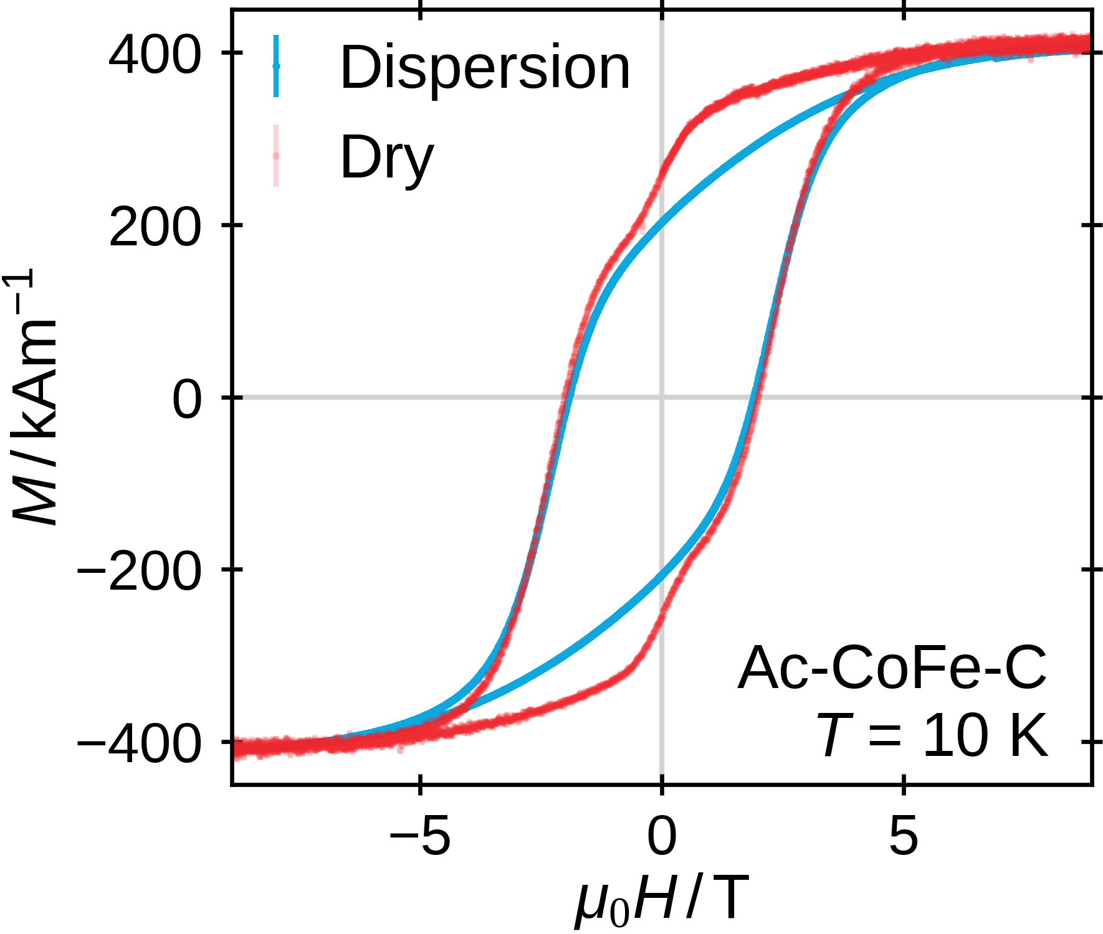
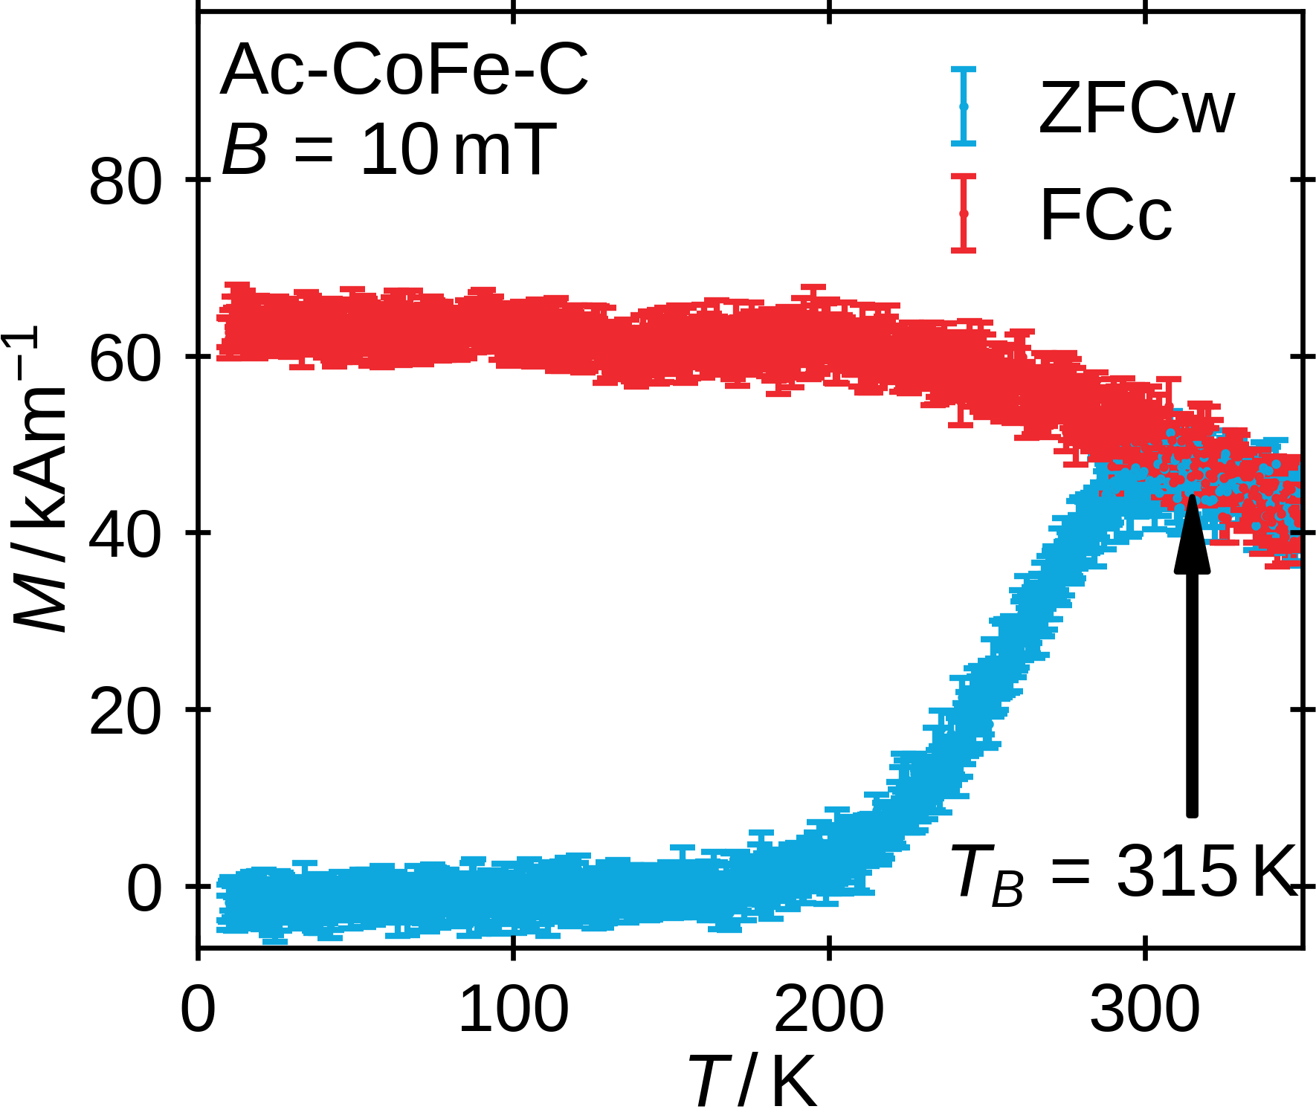
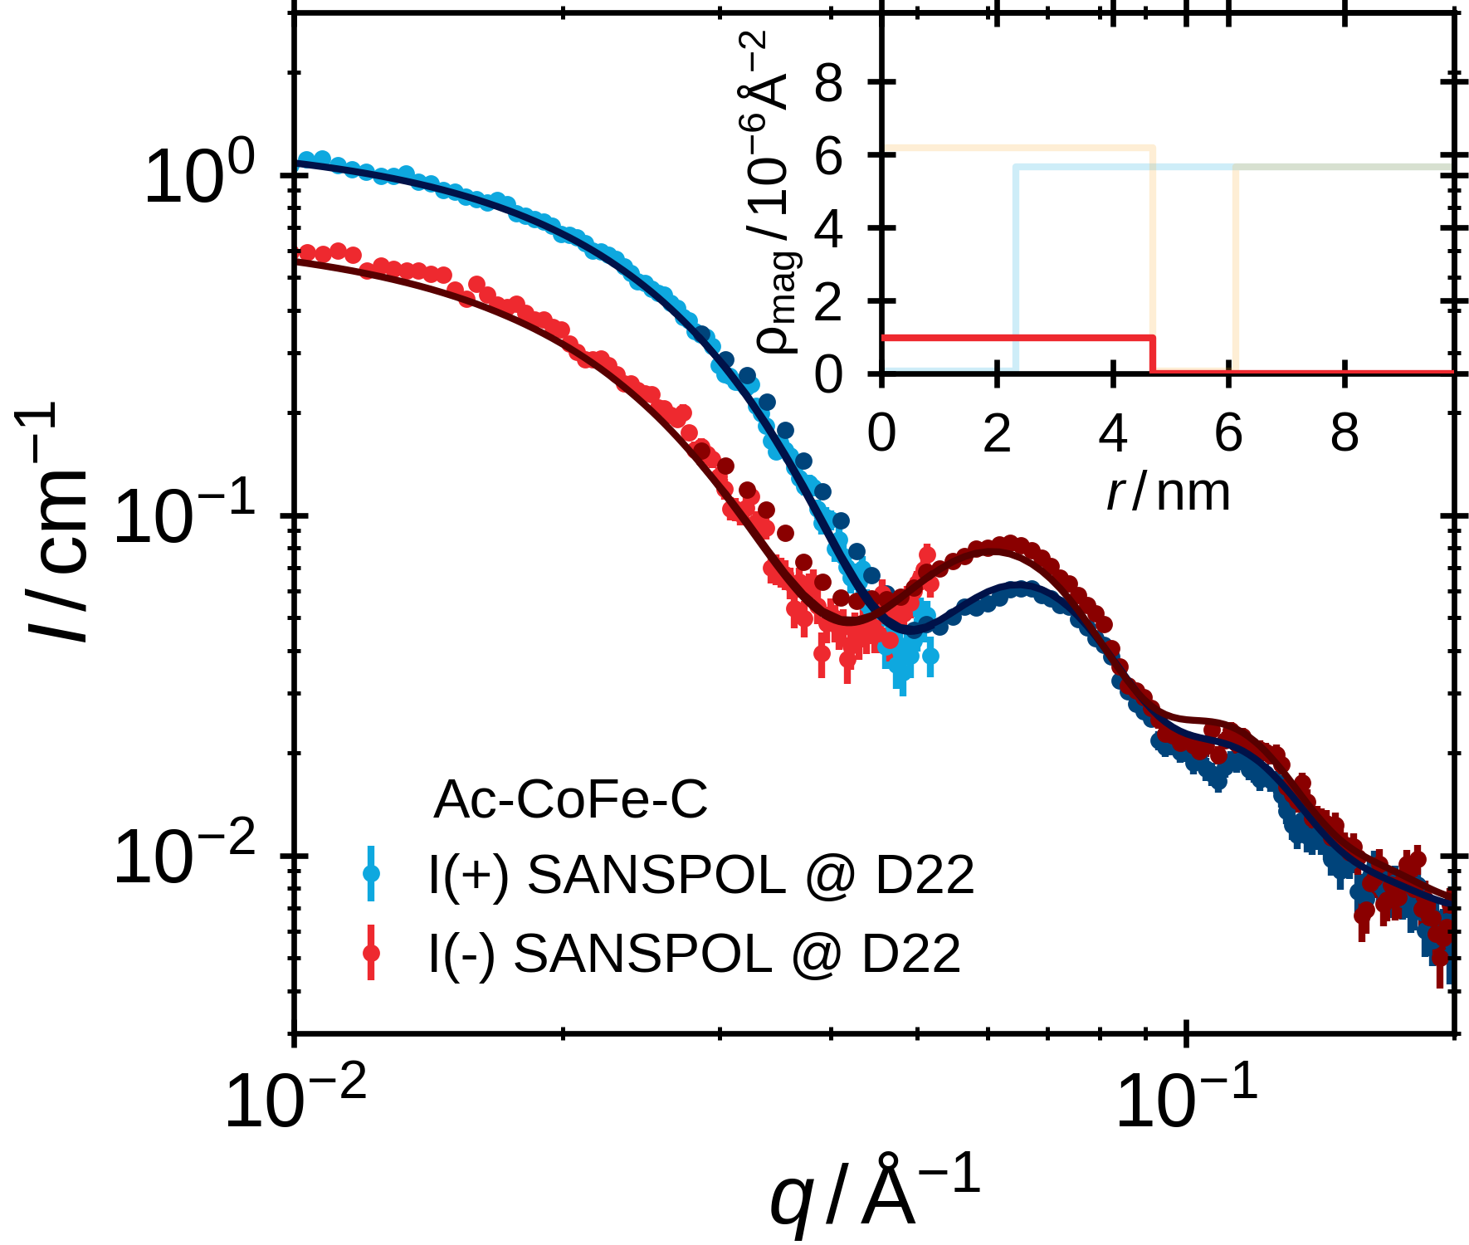
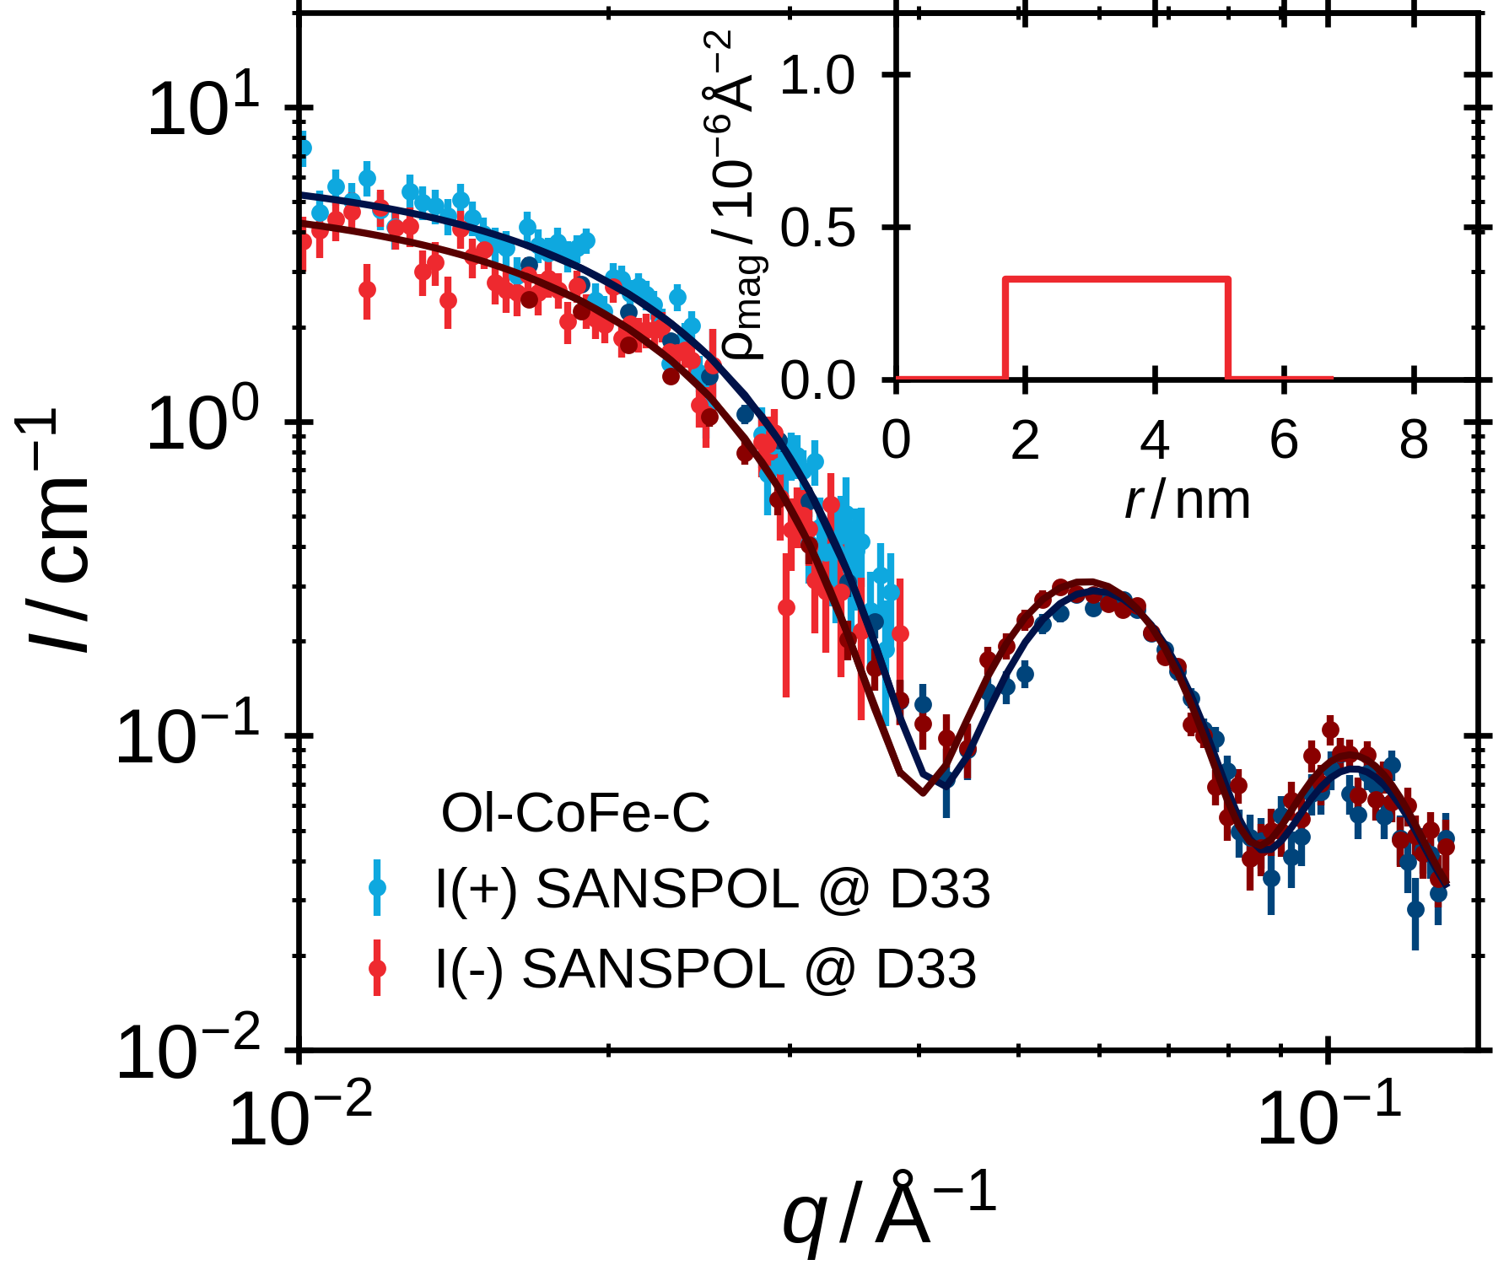
Individual Nanoparticle Magnetism
Field- & Temperature-dependent VSM to study the macroscopic magnetization
SANSPOL to determine the individual nanoparticle spin-density profile
8

Slide 9
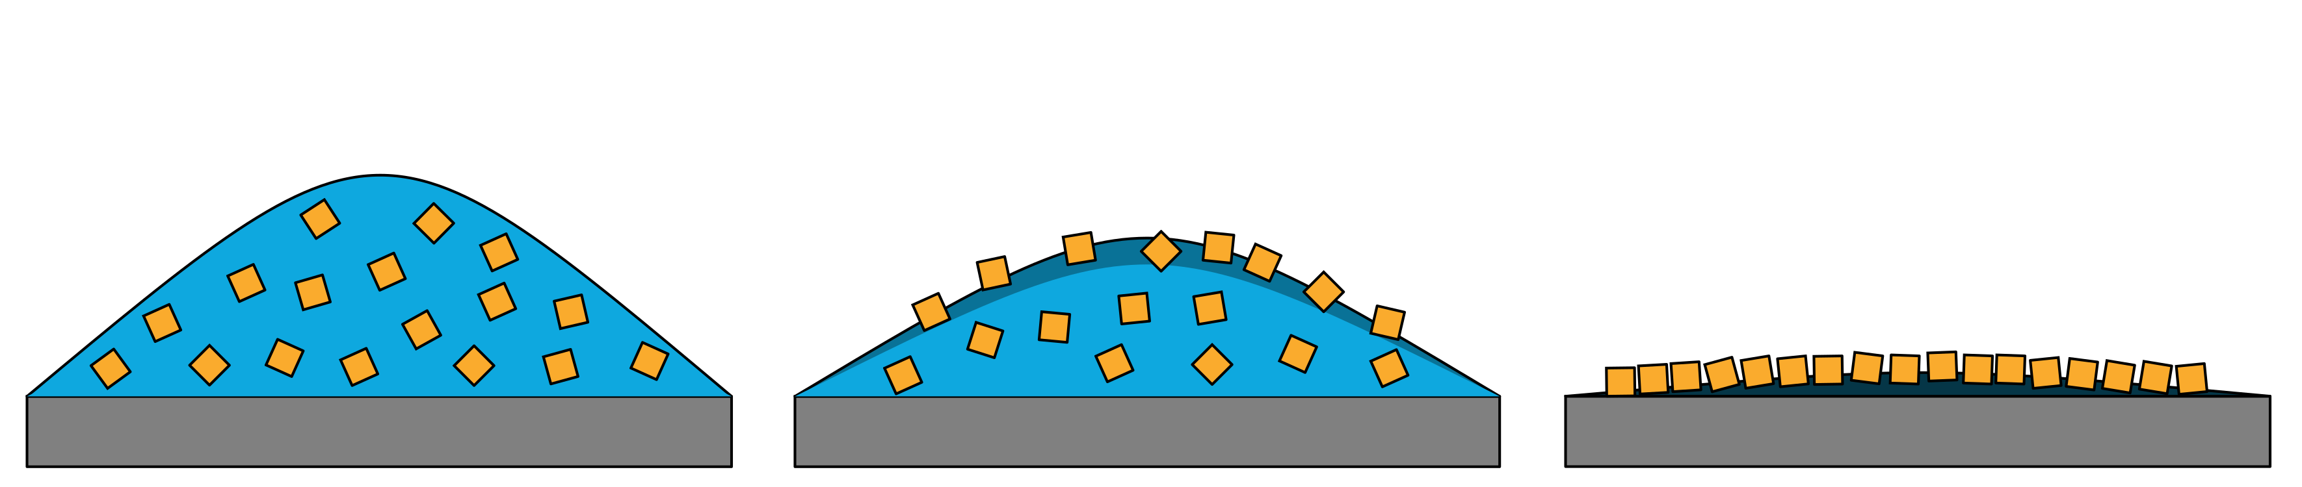
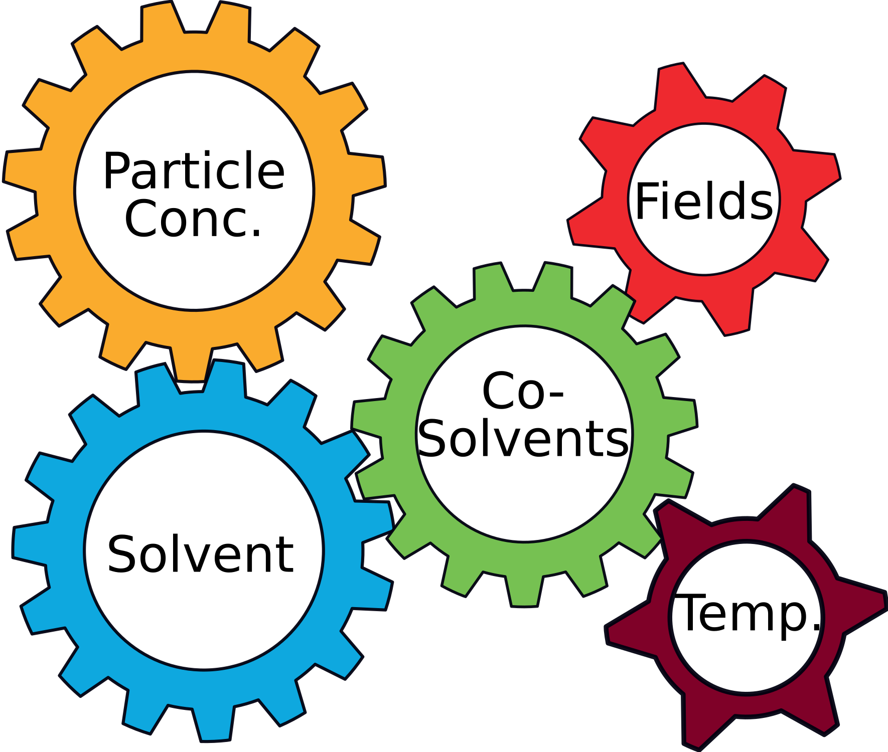
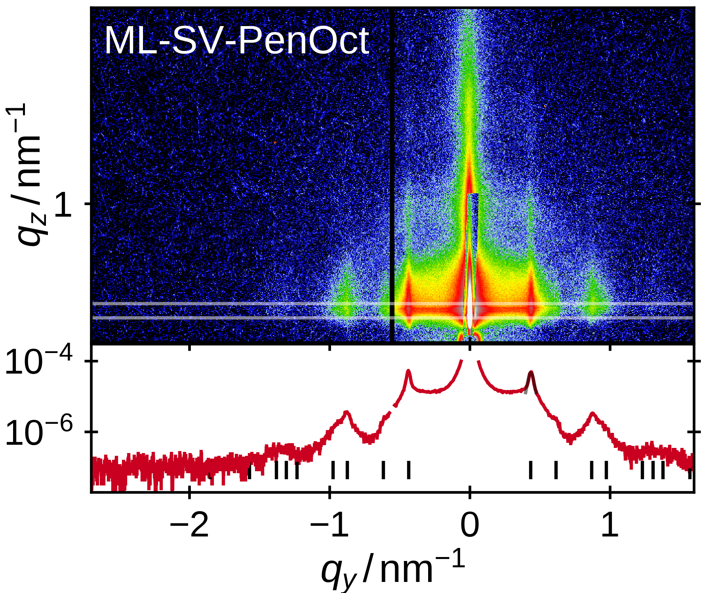
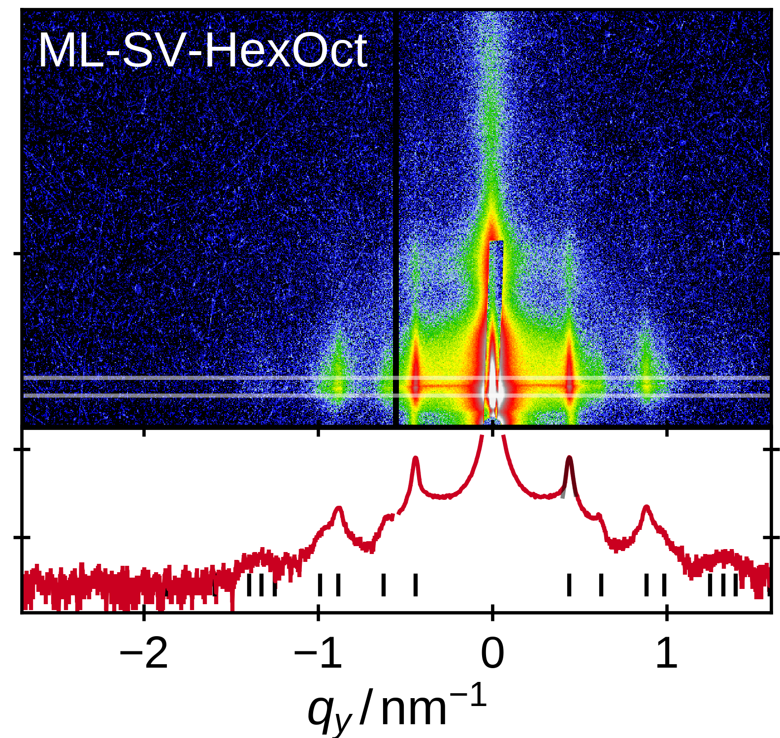
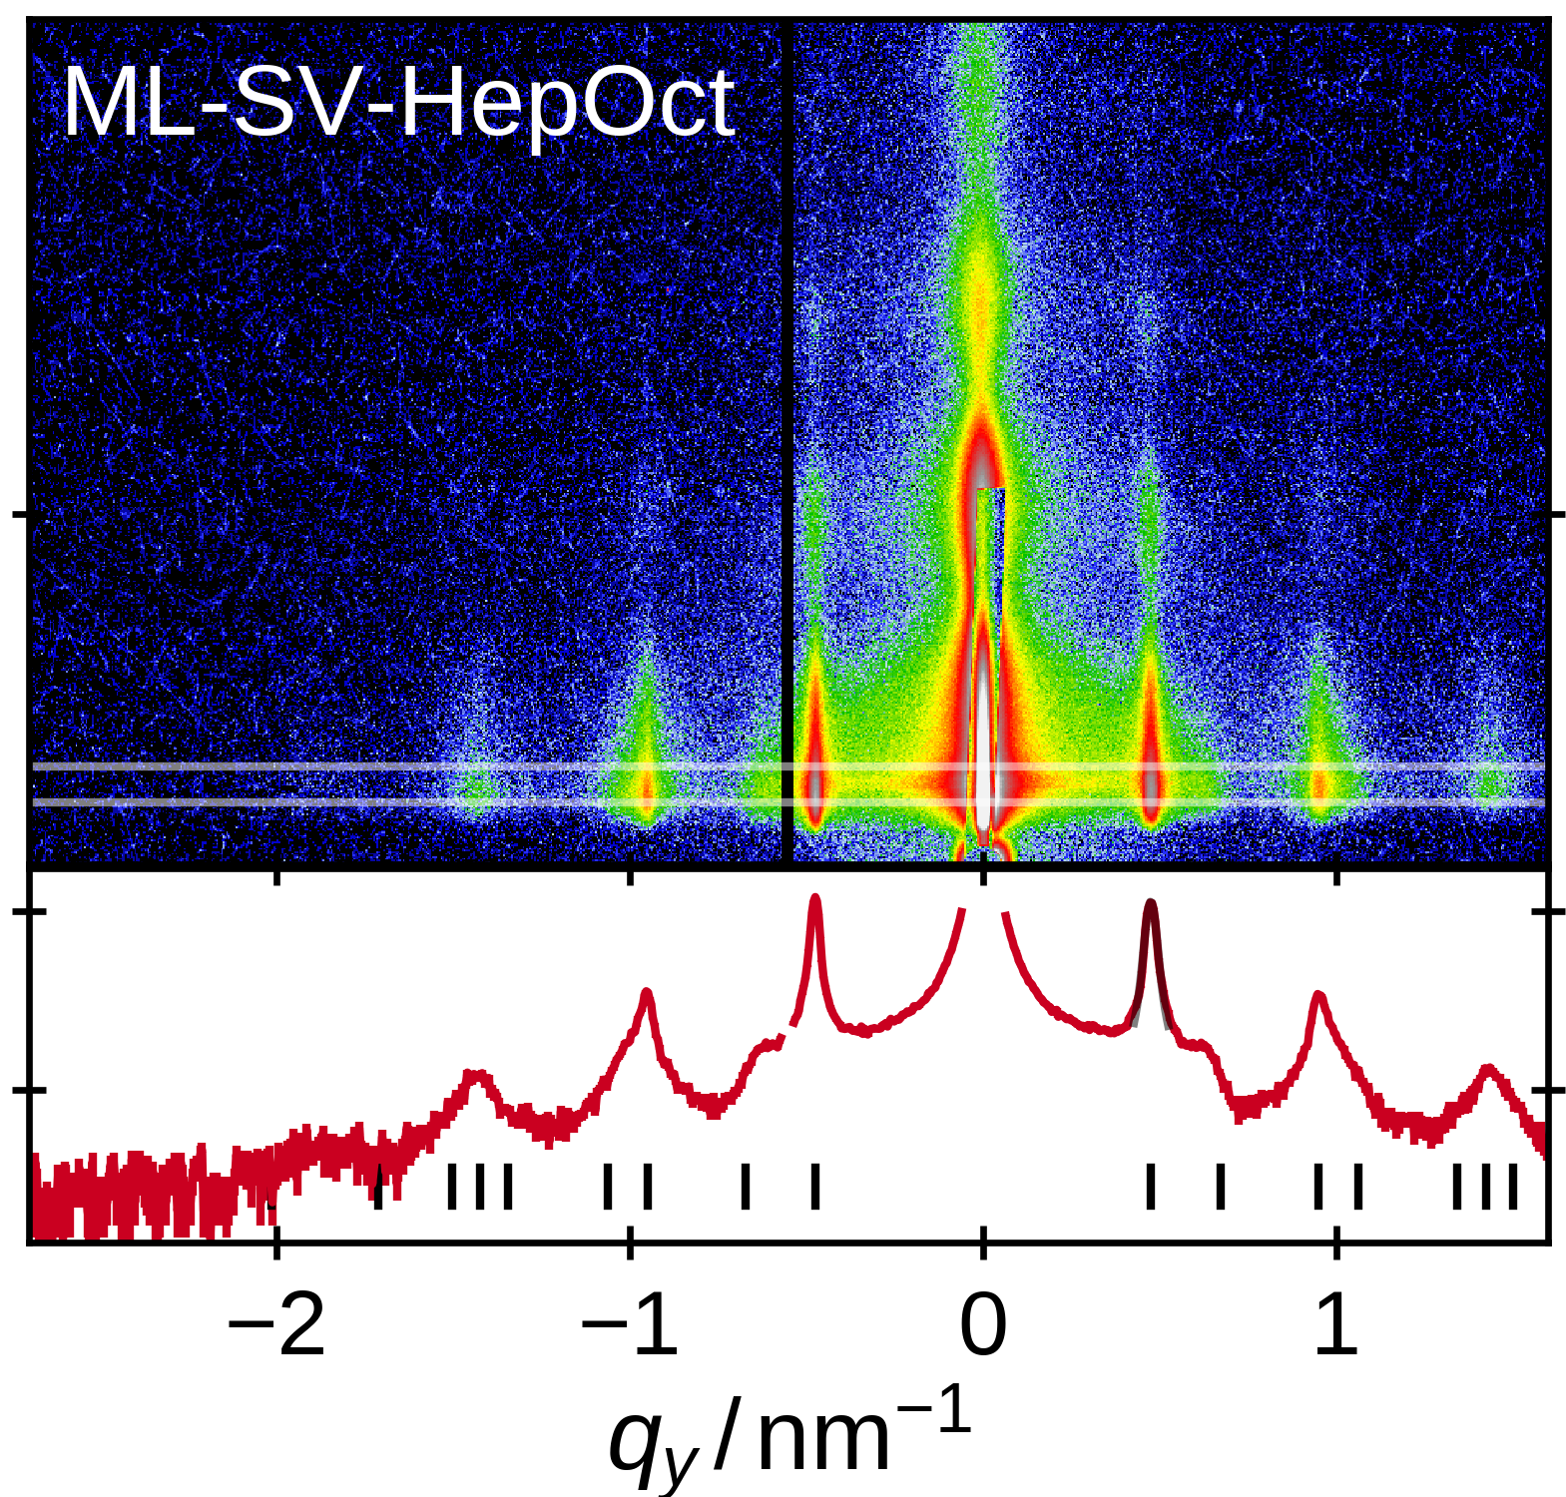
Self-Assembly of Long-Range Ordered Monolayers
Monolayer Preparation by Drop Casting Organic Solvent + Co-Solvent Dispersion
controlled evaporation-driven self-assembly
GISAXS study: variation of alkanes as solvent
n-pentane n-hexane n-heptane
9

Slide 10
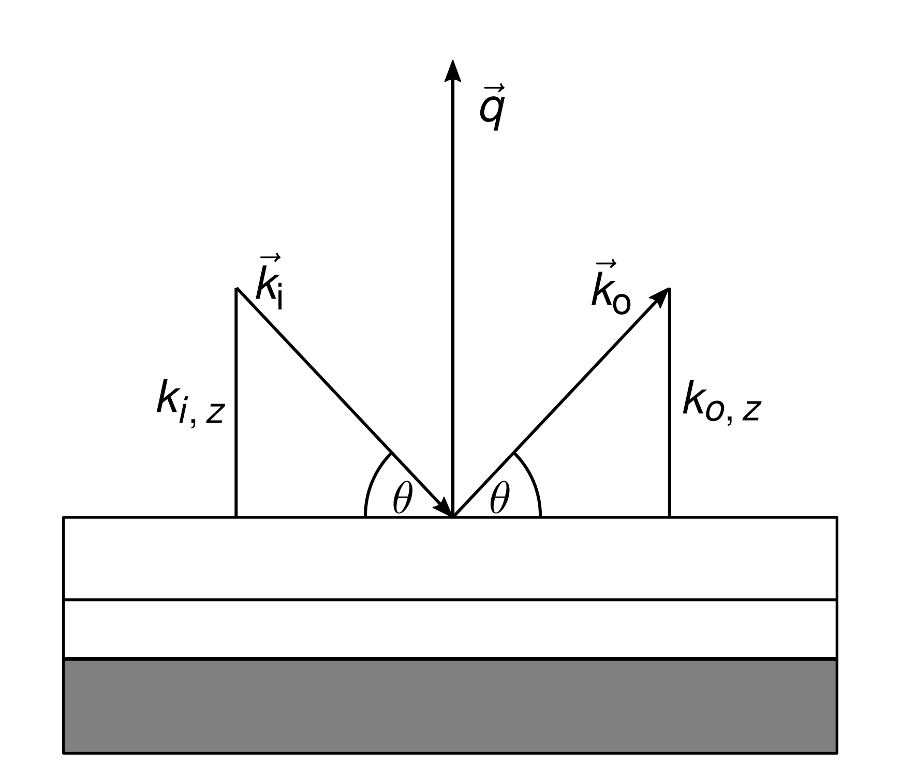
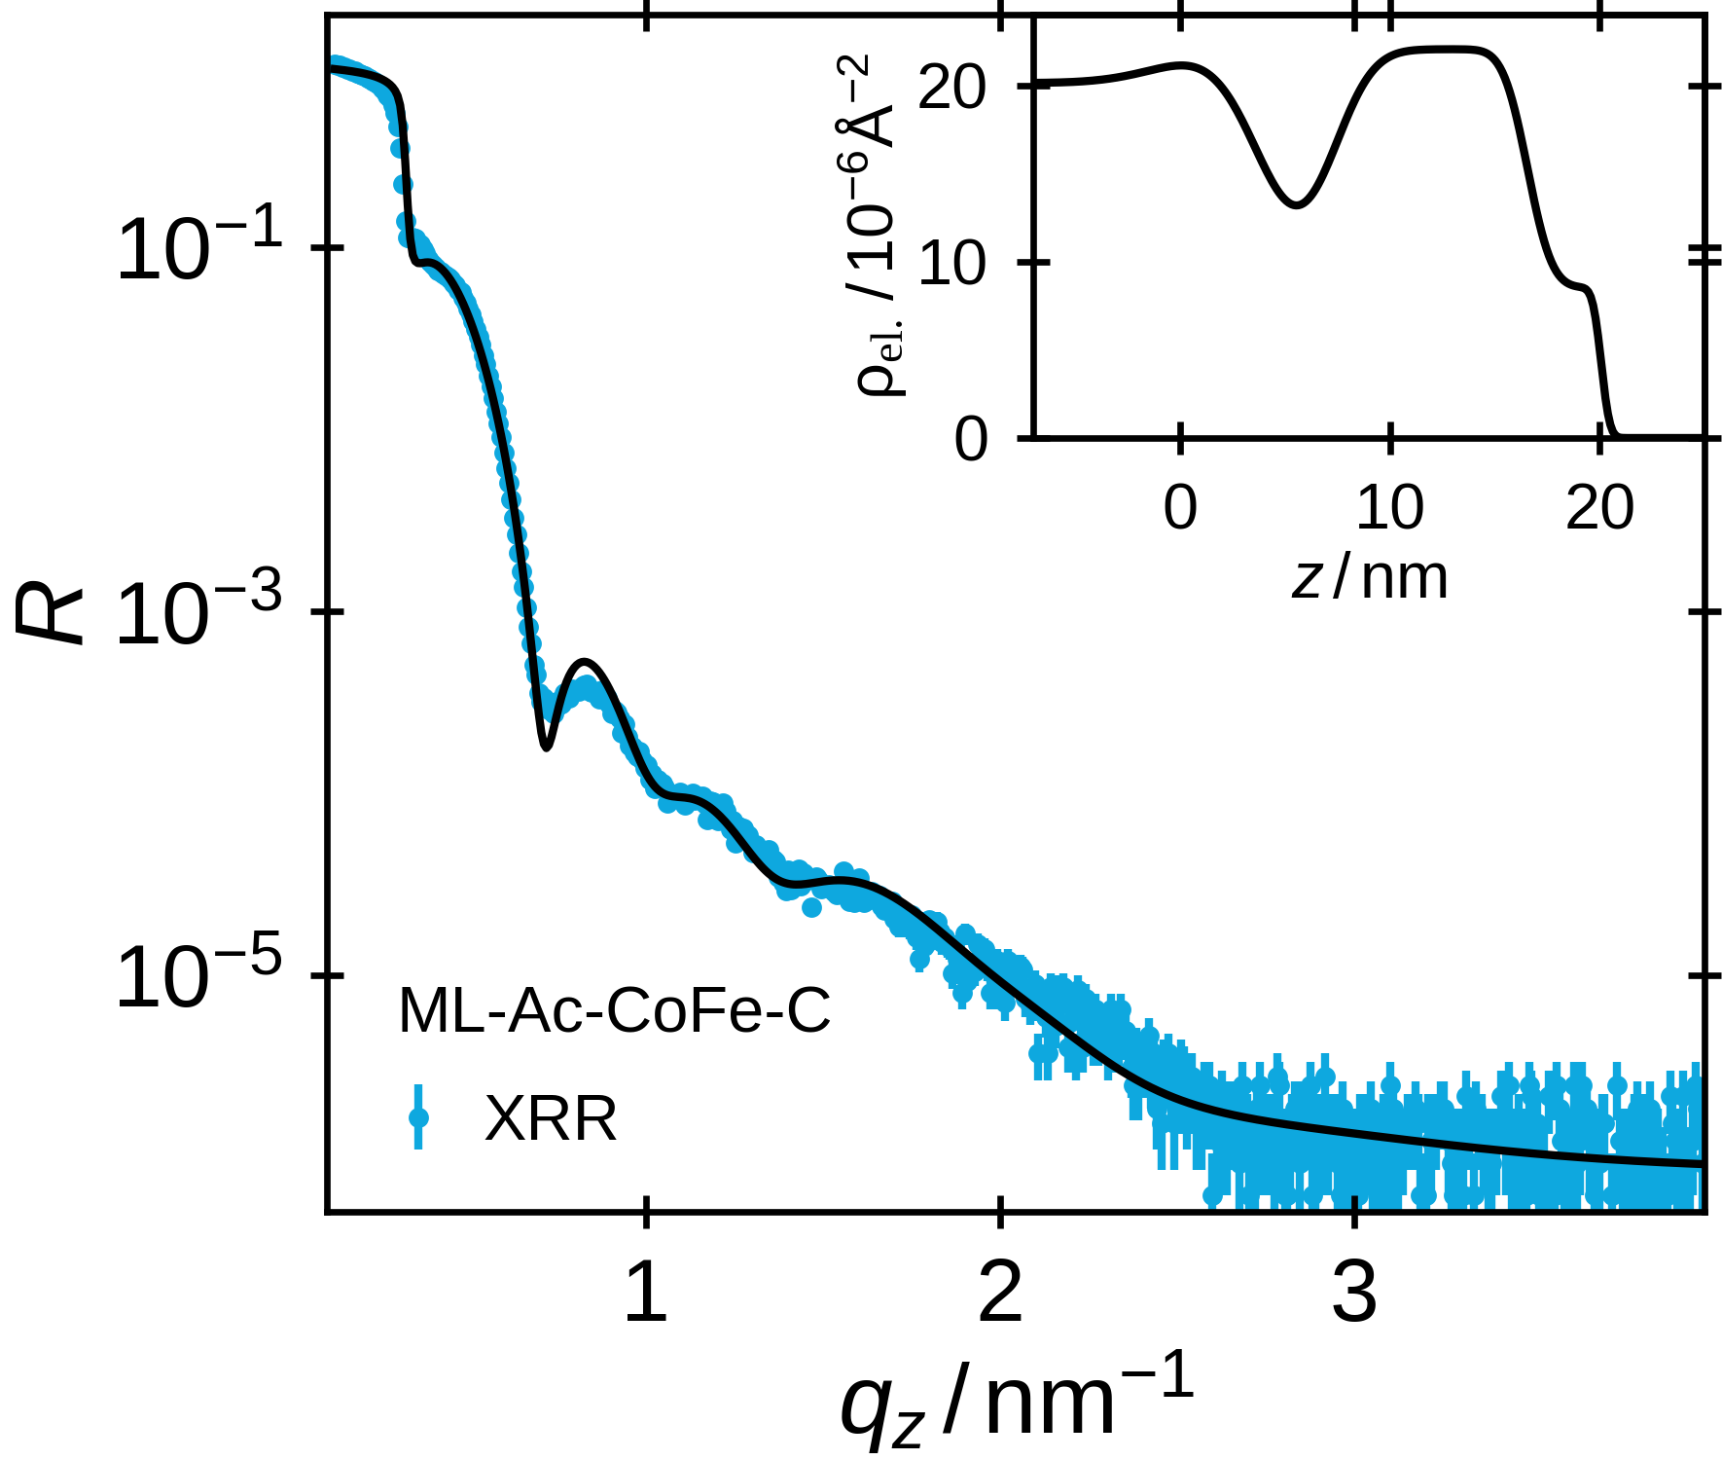
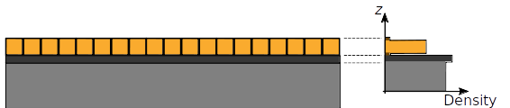
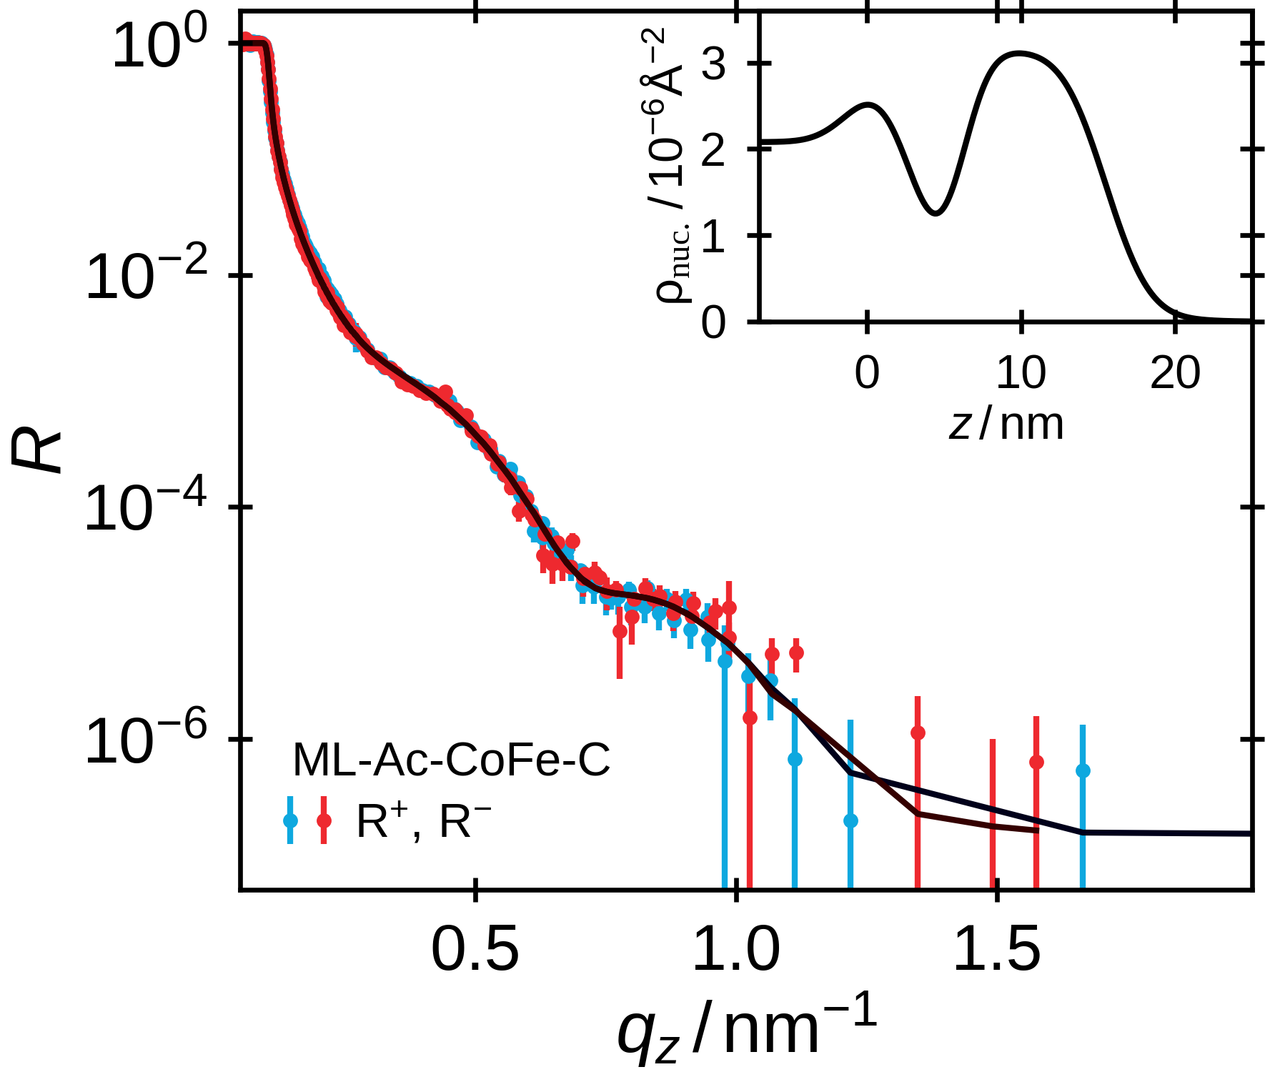
Vertical Structure
X-Ray & (Polarized) Neutron Reflectometry
→ depth-resolved laterally averaged
electron, nuclear & spin density
Model for Monolayer Samples
fix particle properties with previous characterization
→ determine packing density & layer roughness
→ estimate of interparticle spacing
10

Slide 11
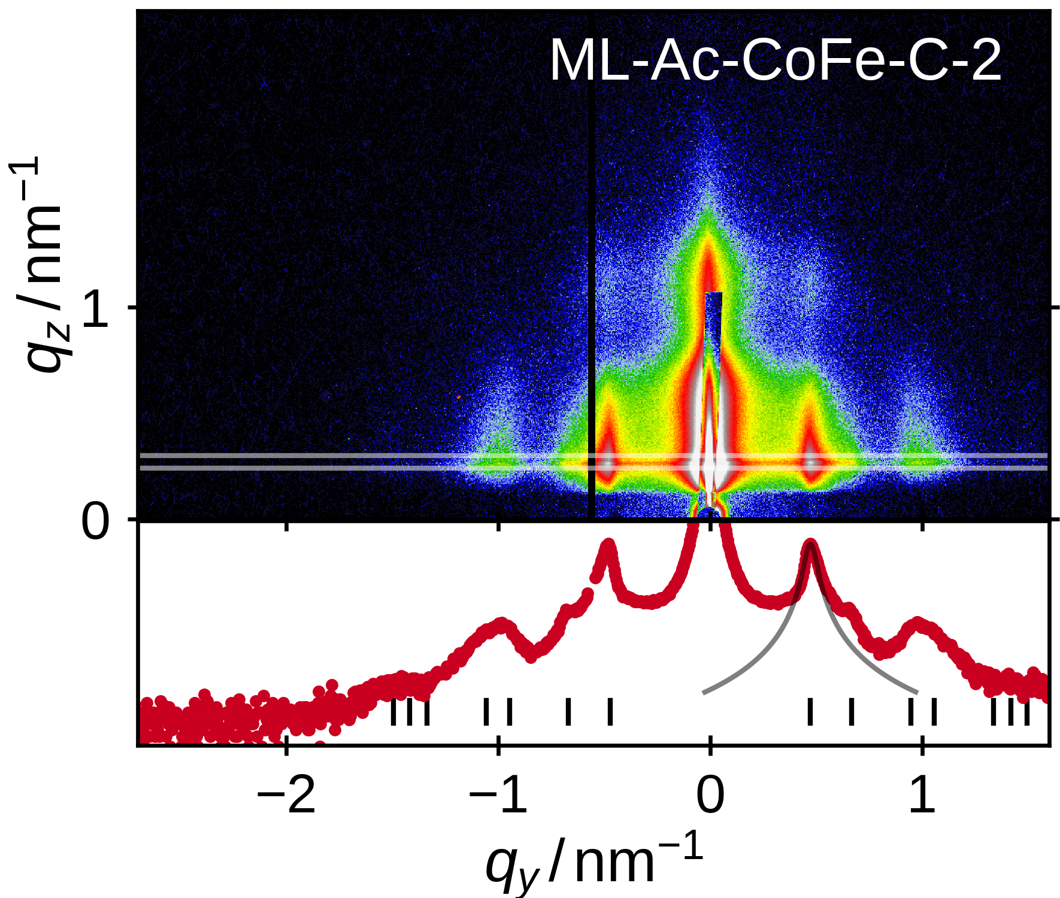
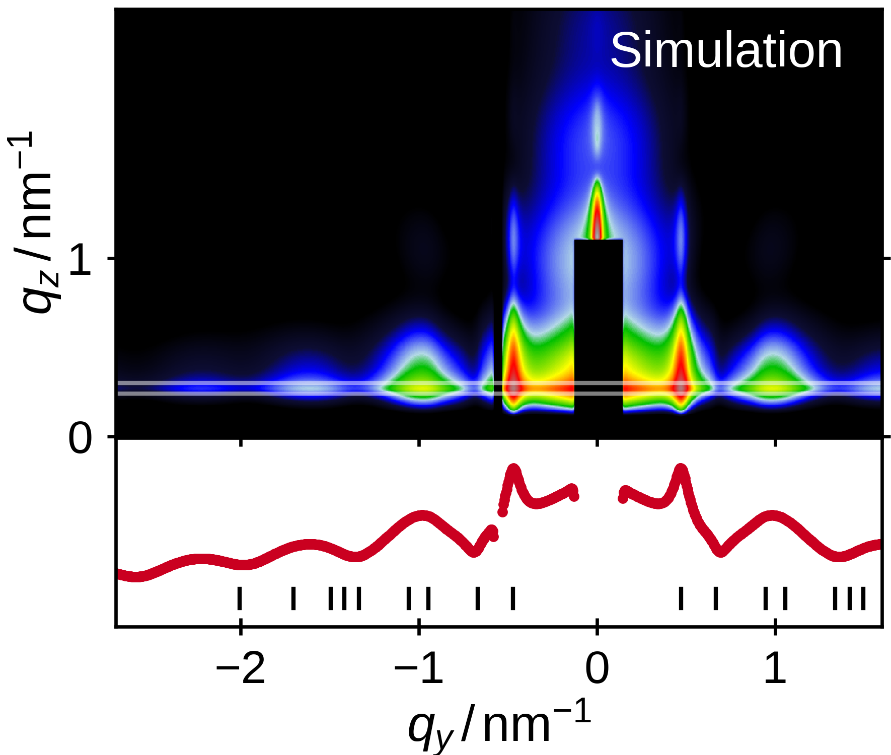
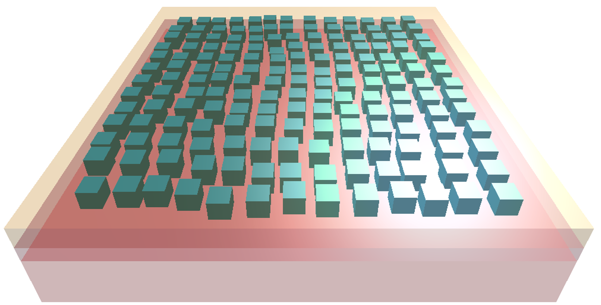
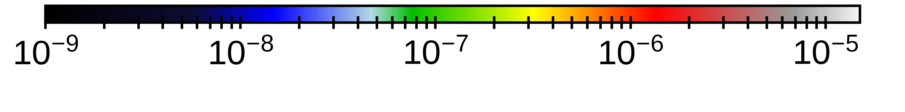
Quantitative Evaluation of Lateral Order
Quantitative evaluation of lateral order from GISAXS using BornAgain^{[1]} to simulate square lattice paracrystal model using nanoparticle characterization & reflectometry result
[1] J. Burle et al., https://www.bornagainproject.org, 2018
11

Slide 12
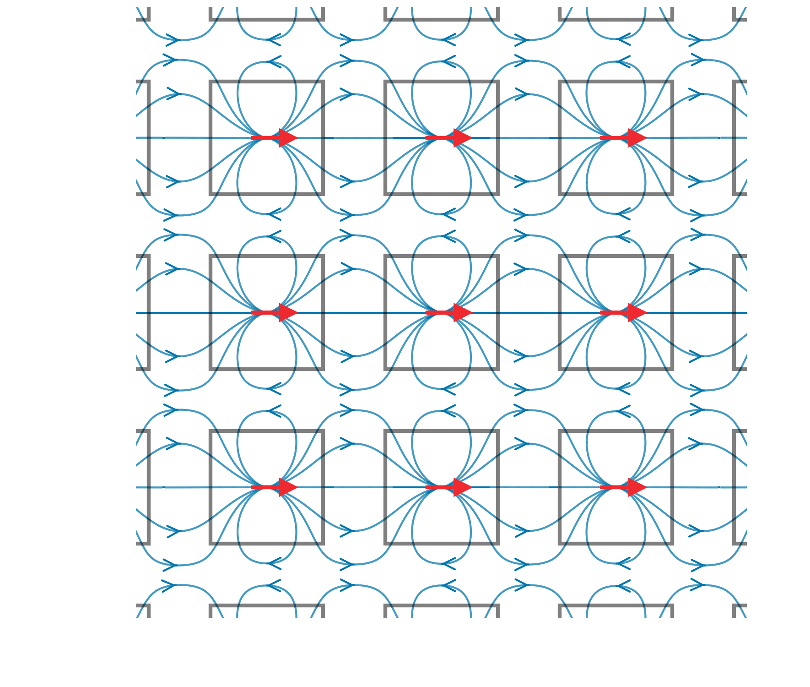
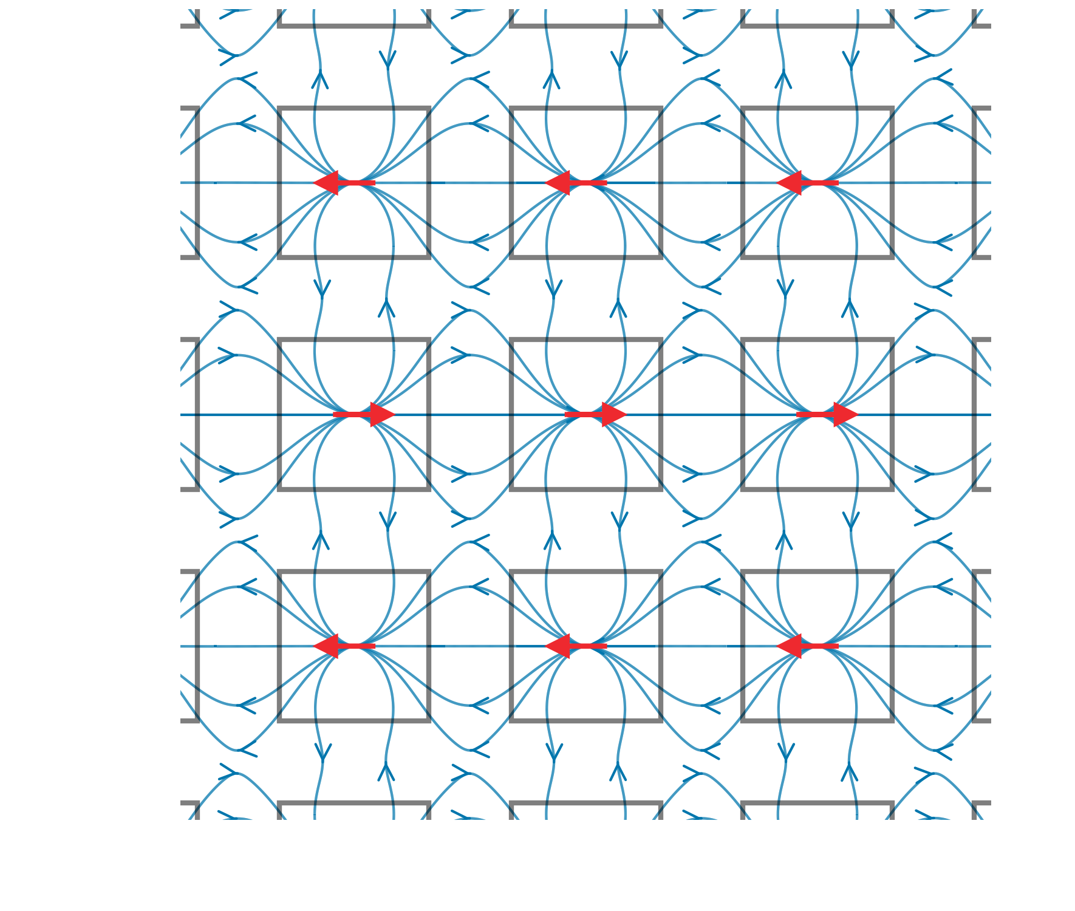
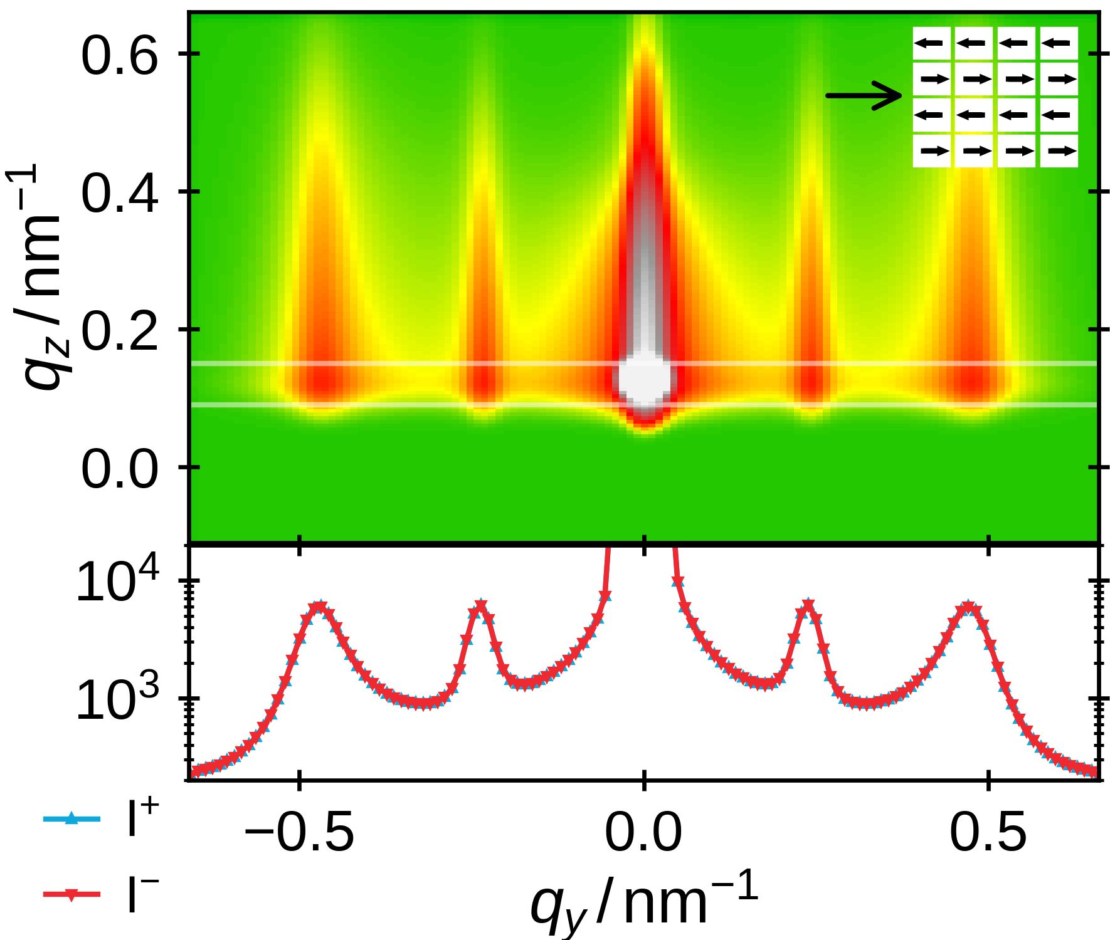
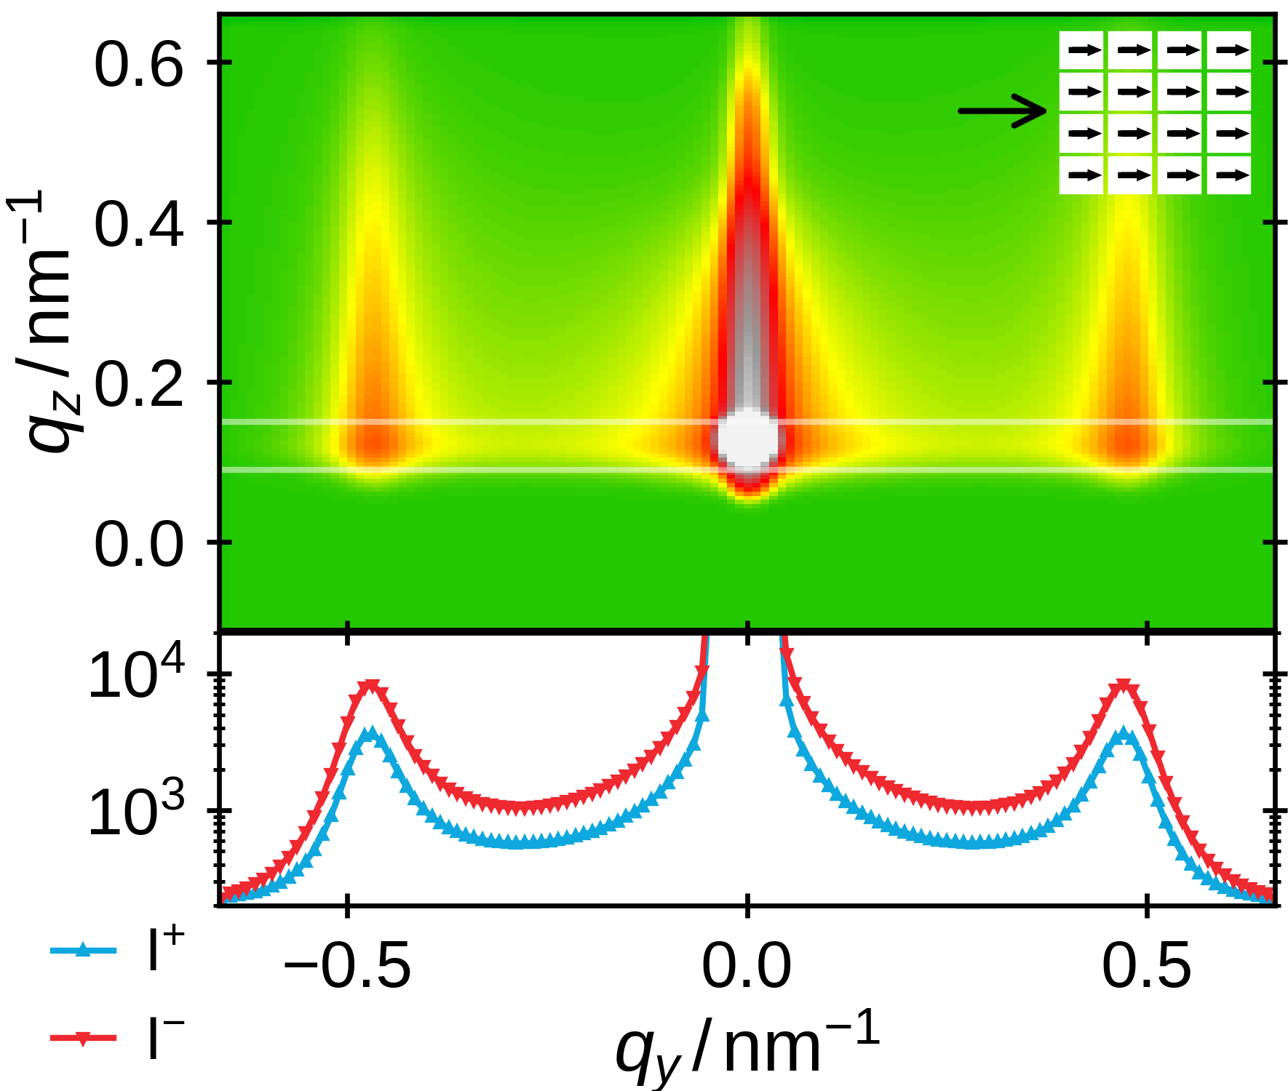
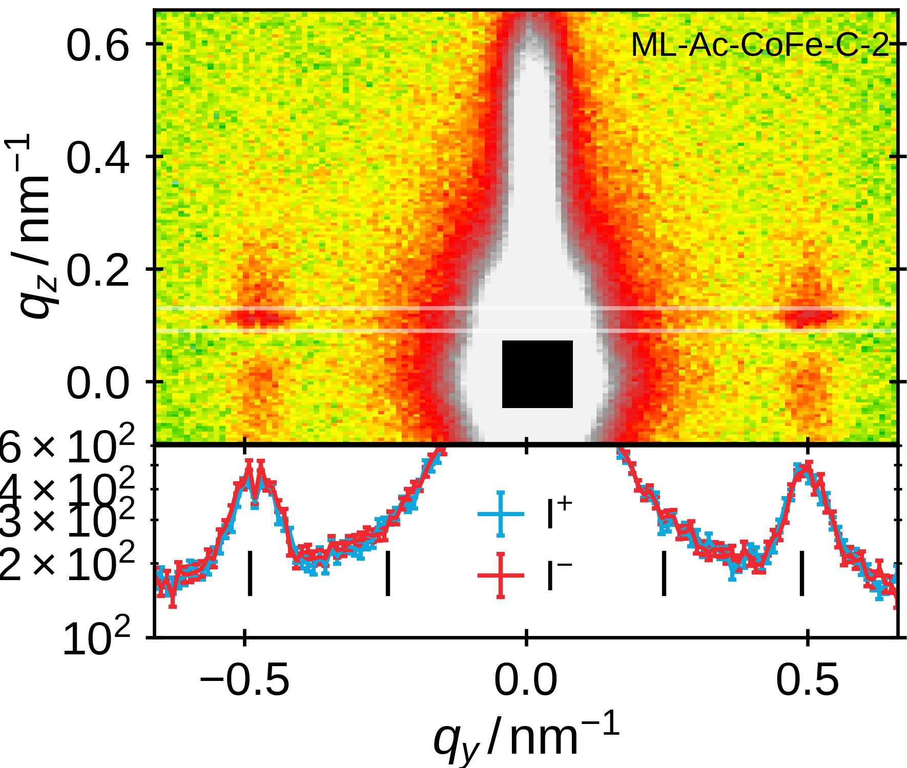
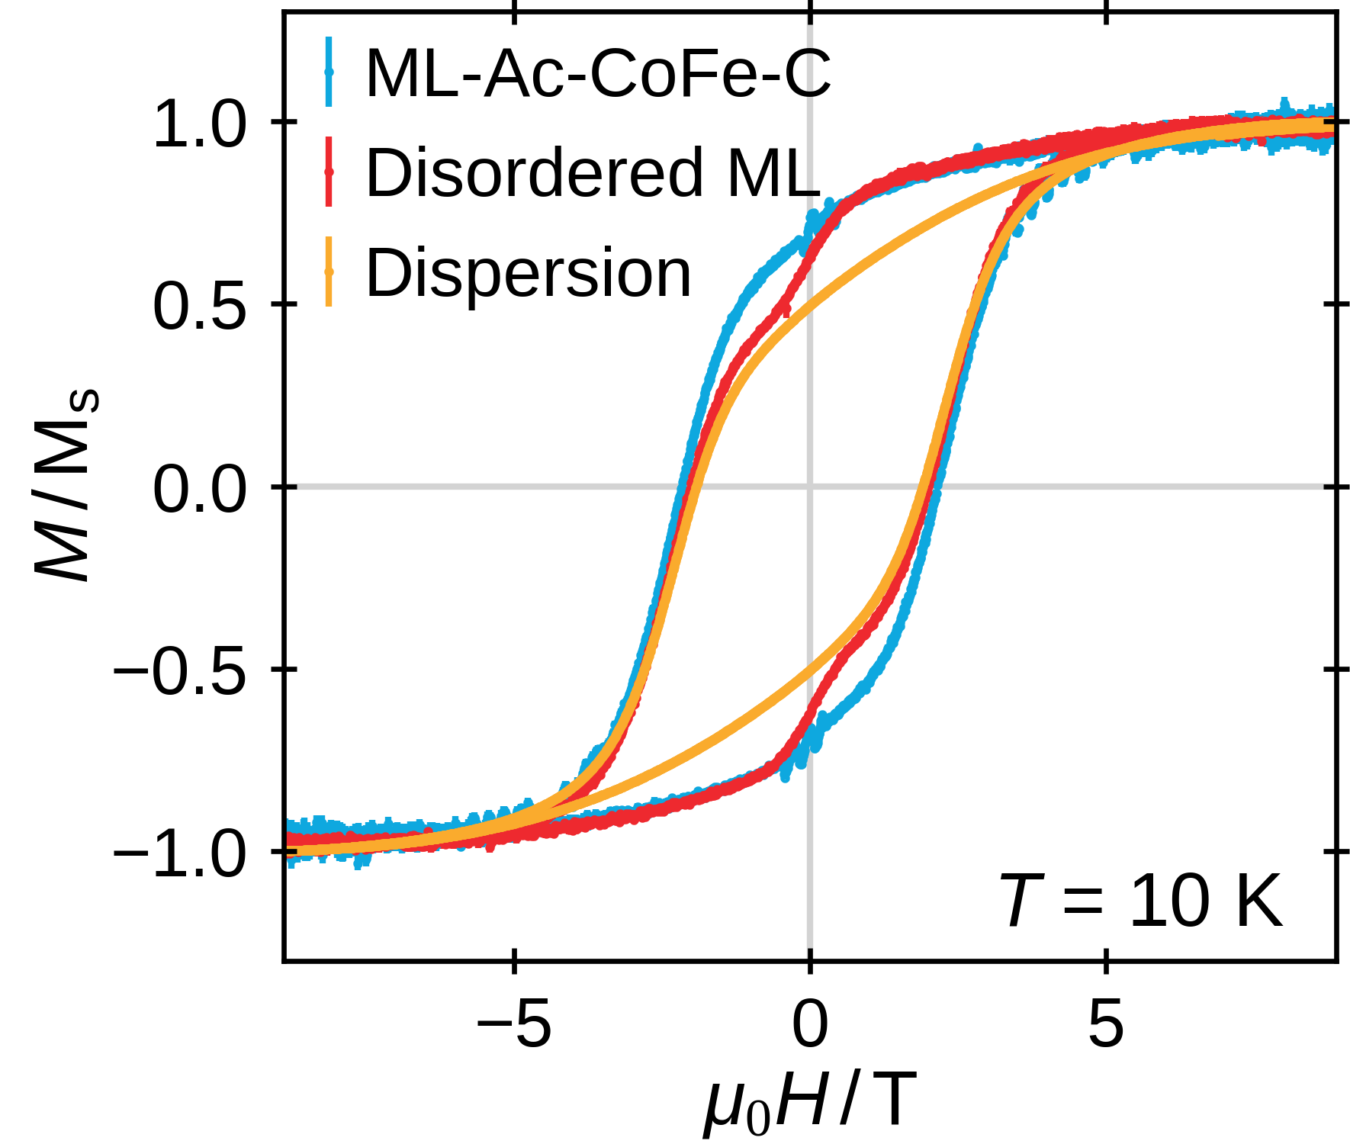
Magnetism in a Monolayer
Ground state of dipolar interacting magnetic moments on a square lattice
super antiferromagnetic^{[1]}
[1] V. Russier, J. Appl. Phys., 2001, 89, 1287-1294.
12

Slide 13
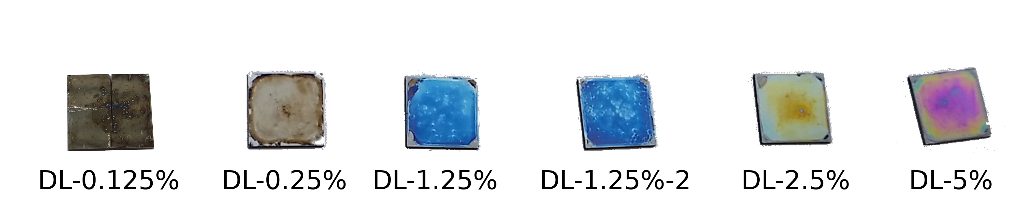


Extension to Double Layers
Double layers prepared by sequential drop-casting
+ add non-magnetic PMMA spacer by spin-coating
13

Slide 14



Search for Dipolar Interlayer Coupling
Simulate model extending monolayer results
→ separation of peak maxima allows differentiation
of FM & AFM coupling
14

Slide 15
Summary
Study of collective magnetism in nanostructures with varying degree of long-range order
In each case, combined investigation of structural & magnetic properties
for individual nanoparticles & nanostructures
Introduction of the superball form factor
Presentation of drop-casting method to prepare long-range ordered monolayers
First systematic study on double layers of magnetic nanoparticles
15

Slide 16




Outlook
Monolayer preparation extendable on variable nanoparticle materials / shapes
Orientationally ordered monolayers by application of magnetic fields during drying
Study of magnetic ground state by locally resolving methods, i.e. electron holography or magnetic force microscopy
Variation of the interlayer spacing material for double layers
Preparation of double layers with varied material combinations
Many variations conceivable → further interesting results can be expected
16

Slide 17






Acknowledgements
Dr. Sabrina Disch
Prof. Dr. Sanjay Mathur
Prof Dr. Uwe Ruschewitz
Dr. Stefan Roitsch
Maria Hentschel
Flore Mees
Dominika Zákutná
Yannic Falke
Daniel Stadler
Ali Al Mawla
Kevin Graeff
Prof. Dr. Annette Schmidt
& her workgroup
Dr. Emmanuel Kentzinger
Michael Smik
Dr. Dirk Honecker
Dr. Thomas Saerbeck
Dr. Alexei Vorobiev
Dr. Gunnar Pálsson
Dr. Anton Devishvili
Dr. Stefan Mattauch
Dr. Alexandros Koutsioumpas
Christian Tobeck
Markus Krüger
Rajitha Ravithas
Anne Hansen
Prof. Dr. Wolfgang Tremel
Dr. Kristina Wichmann
Eugen Schechtel
Dr. Daniel Nižňanský
Viktor Klippert & the workshop
Verband der Chemischen Industrie
17

